Slide 1
Outline
●
Kruskal's Algorithm
●
A different algorithm for finding MSTs.
●
Disjoint-Set Forests
●
A specialized data structure for speeding up Kruskal's algorithm.

Slide 2
A Different Approach:
Kruskal's Algorithm

Slide 3
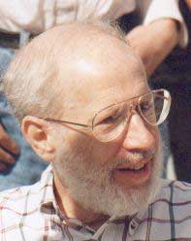
1956: Kruskal

Slide 4
Kruskal's Algorithm
●
Kruskal's Algorithm is the following:
Let T = Ø.
For each edge (u, v) sorted by cost:
– If u and v are not already connected in T, add (u, v) to T.
●
●
●
Can prove by induction that the result is a spanning tree by showing that
Exactly n – 1 edges are added.
No edges are added that close a cycle.
●
●

Slide 5
7
7
5
5
6
5
6
4
7
1
3
6
4
4
2
3
6
4

Slide 6
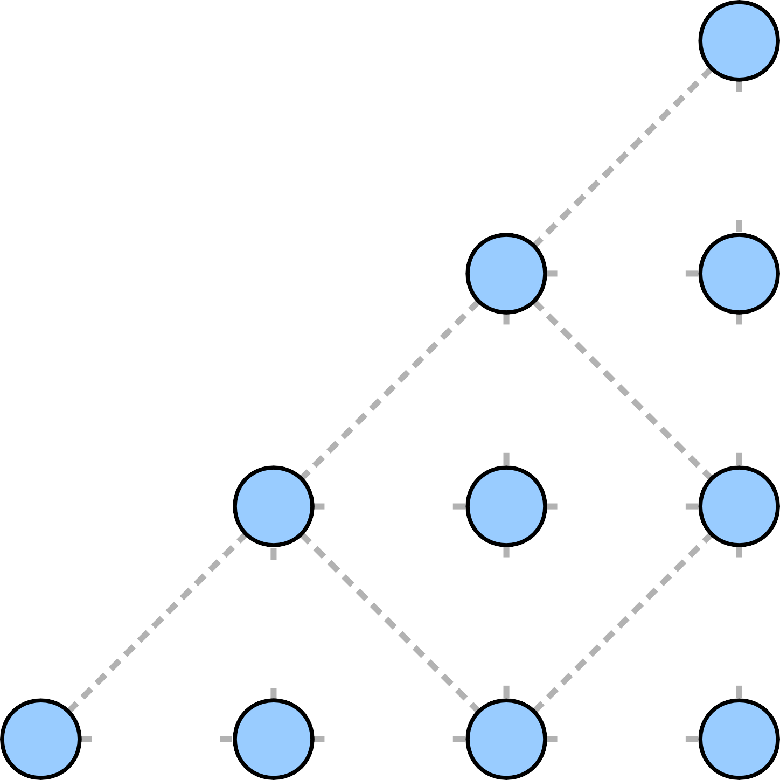
7
7
5
5
6
5
6
4
7
1
3
6
4
4
2
3
6
4

Slide 7
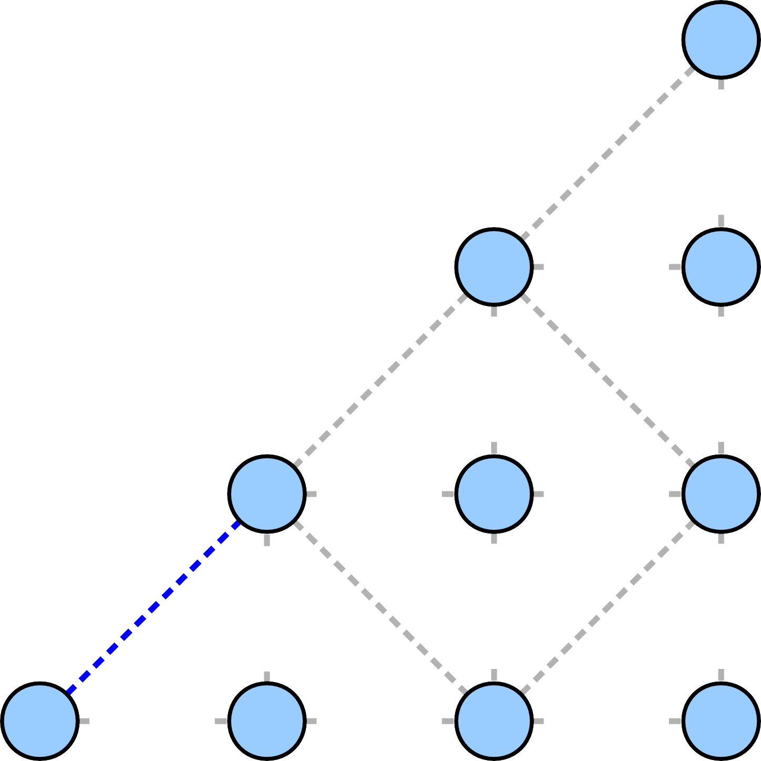
7
7
5
5
6
5
6
4
7
1
3
6
4
4
2
3
6
4

Slide 8
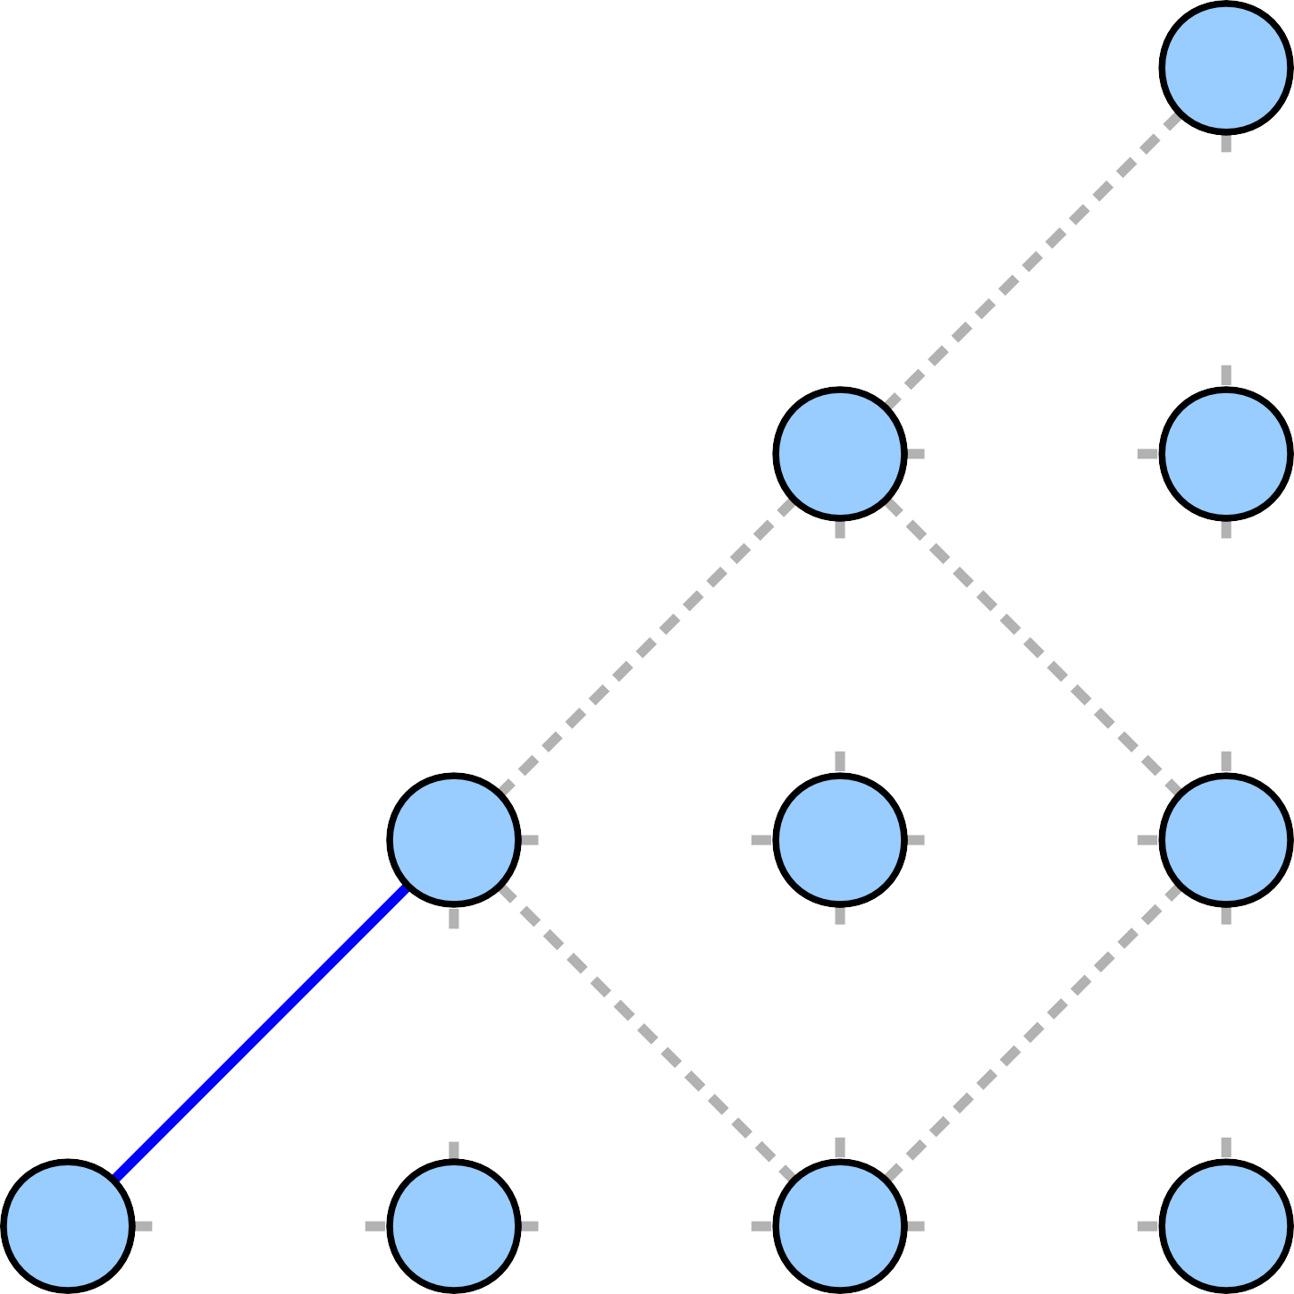
7
7
5
5
6
5
6
4
7
1
3
6
4
4
2
3
6
4

Slide 9
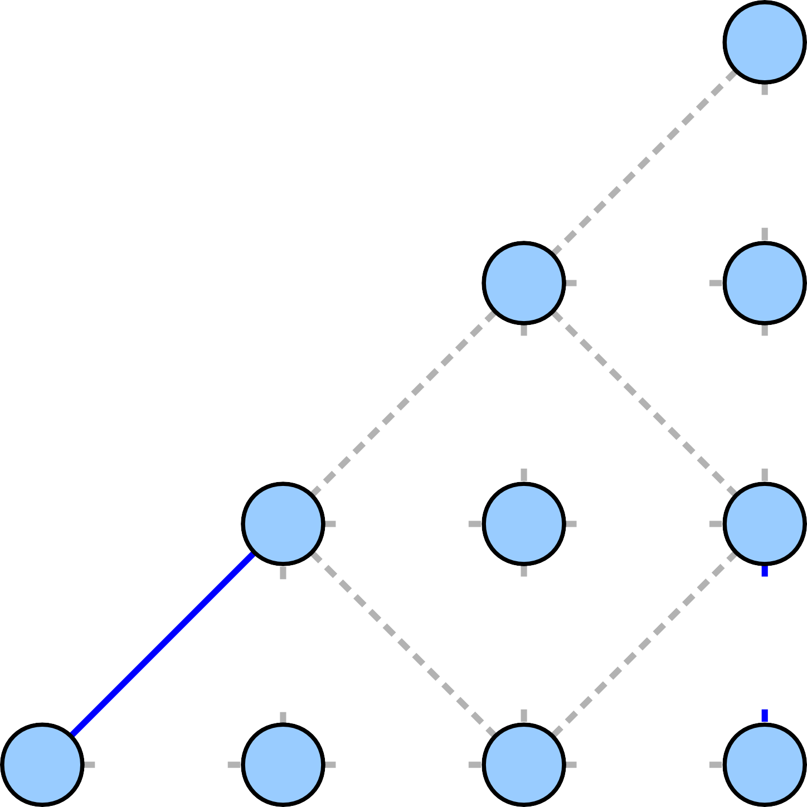
7
7
5
5
6
5
6
4
7
1
3
6
4
4
2
3
6
4

Slide 10
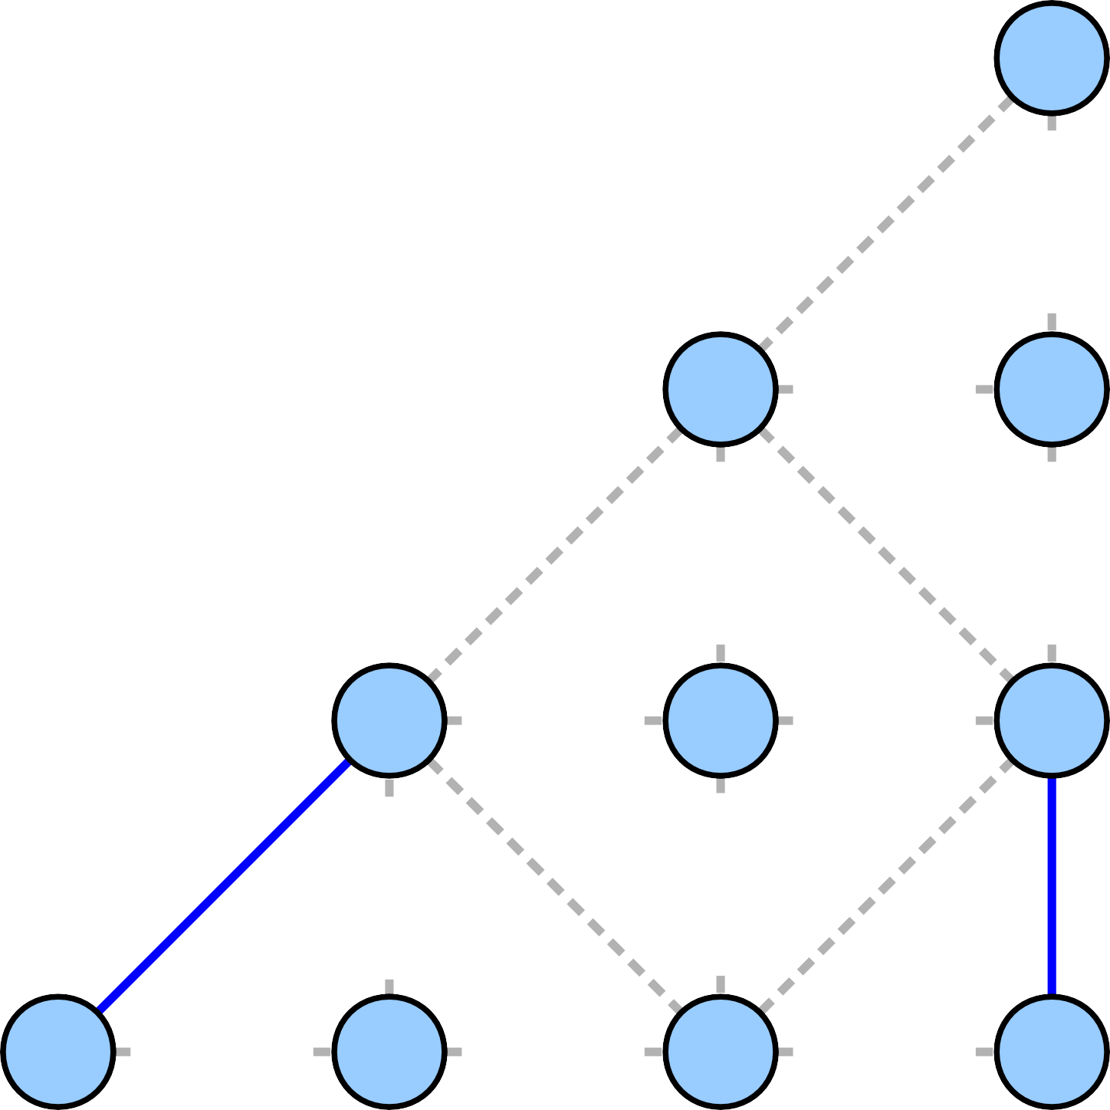
7
7
5
5
6
5
6
4
7
1
3
6
4
4
2
3
6
4

Slide 11
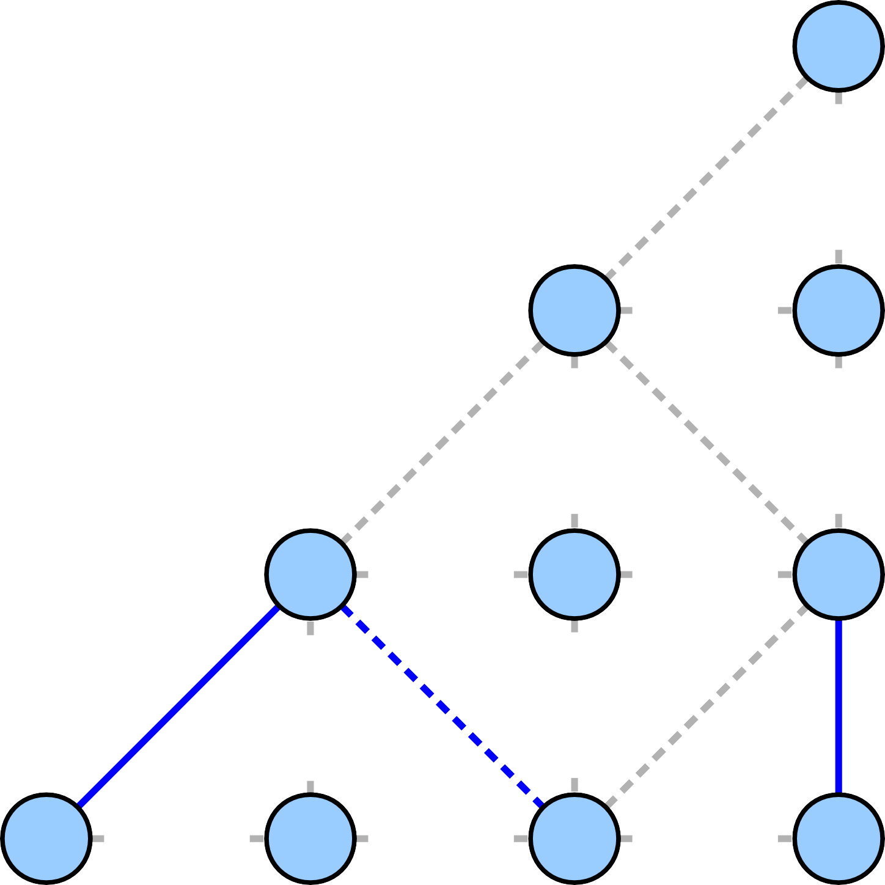
7
7
5
5
6
5
6
4
7
1
3
6
4
4
2
3
6
4

Slide 12
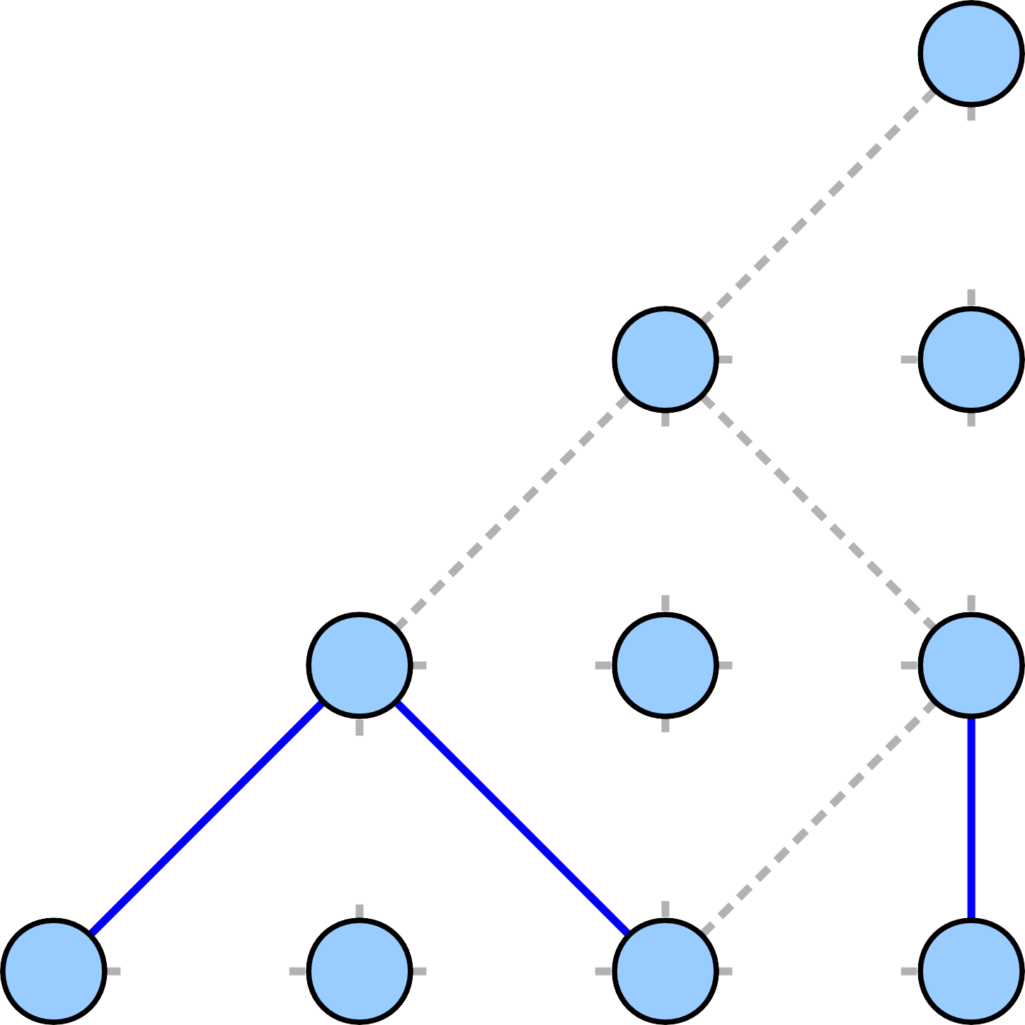
7
7
5
5
6
5
6
4
7
1
3
6
4
4
2
3
6
4

Slide 13

7
7
5
5
6
5
6
4
7
1
3
6
4
4
2
3
6
4

Slide 14
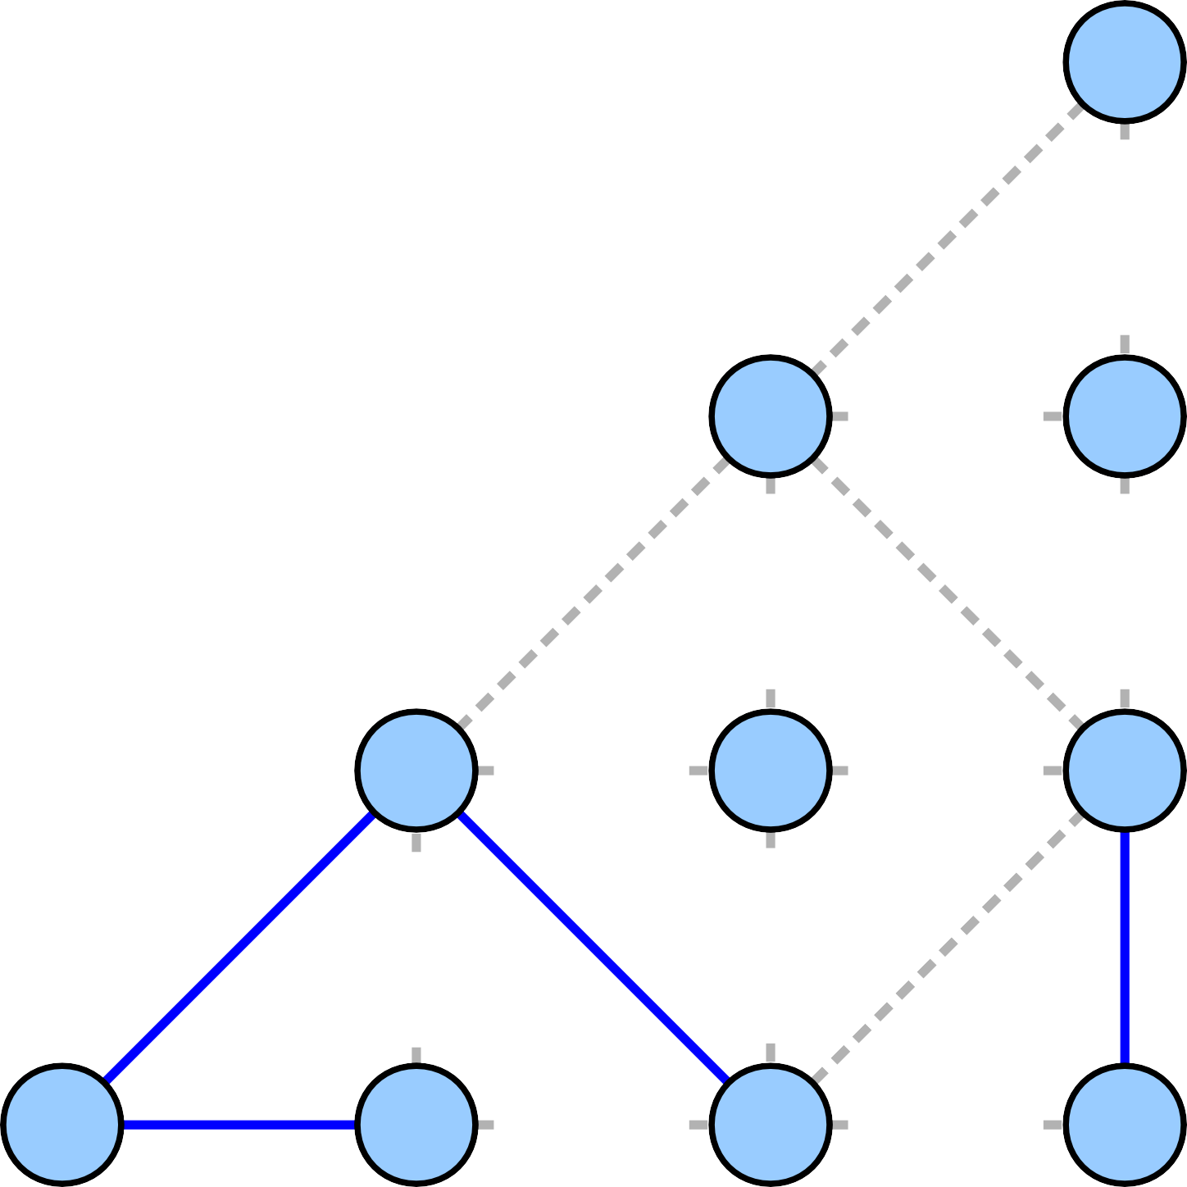
7
7
5
5
6
5
6
4
7
1
3
6
4
4
2
3
6
4

Slide 15

7
7
5
5
6
5
6
4
7
1
3
6
4
4
2
3
6
4

Slide 16

7
7
5
5
6
5
6
4
7
1
3
6
4
4
2
3
6
4

Slide 17

7
7
5
5
6
5
6
4
7
1
3
6
4
2
3
6
4

Slide 18

7
7
5
5
6
5
6
4
7
1
3
6
4
2
3
6
4

Slide 19
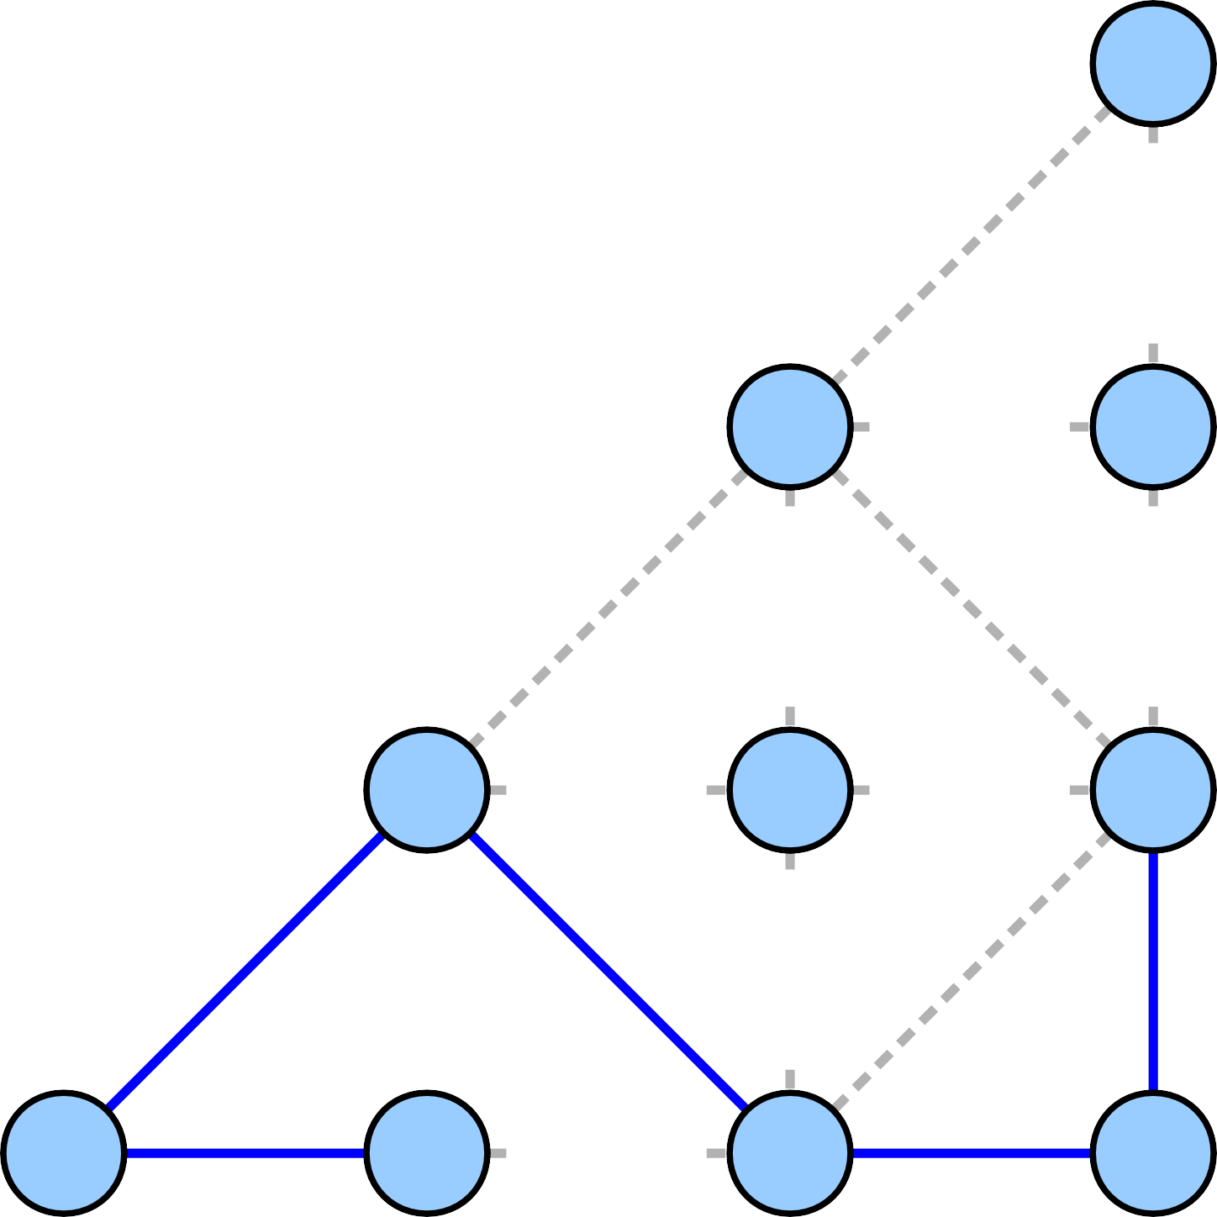
7
7
5
5
6
5
6
4
7
1
3
6
4
2
3
6
4

Slide 20

7
7
5
5
6
5
6
4
7
1
3
6
4
2
3
6
4

Slide 21
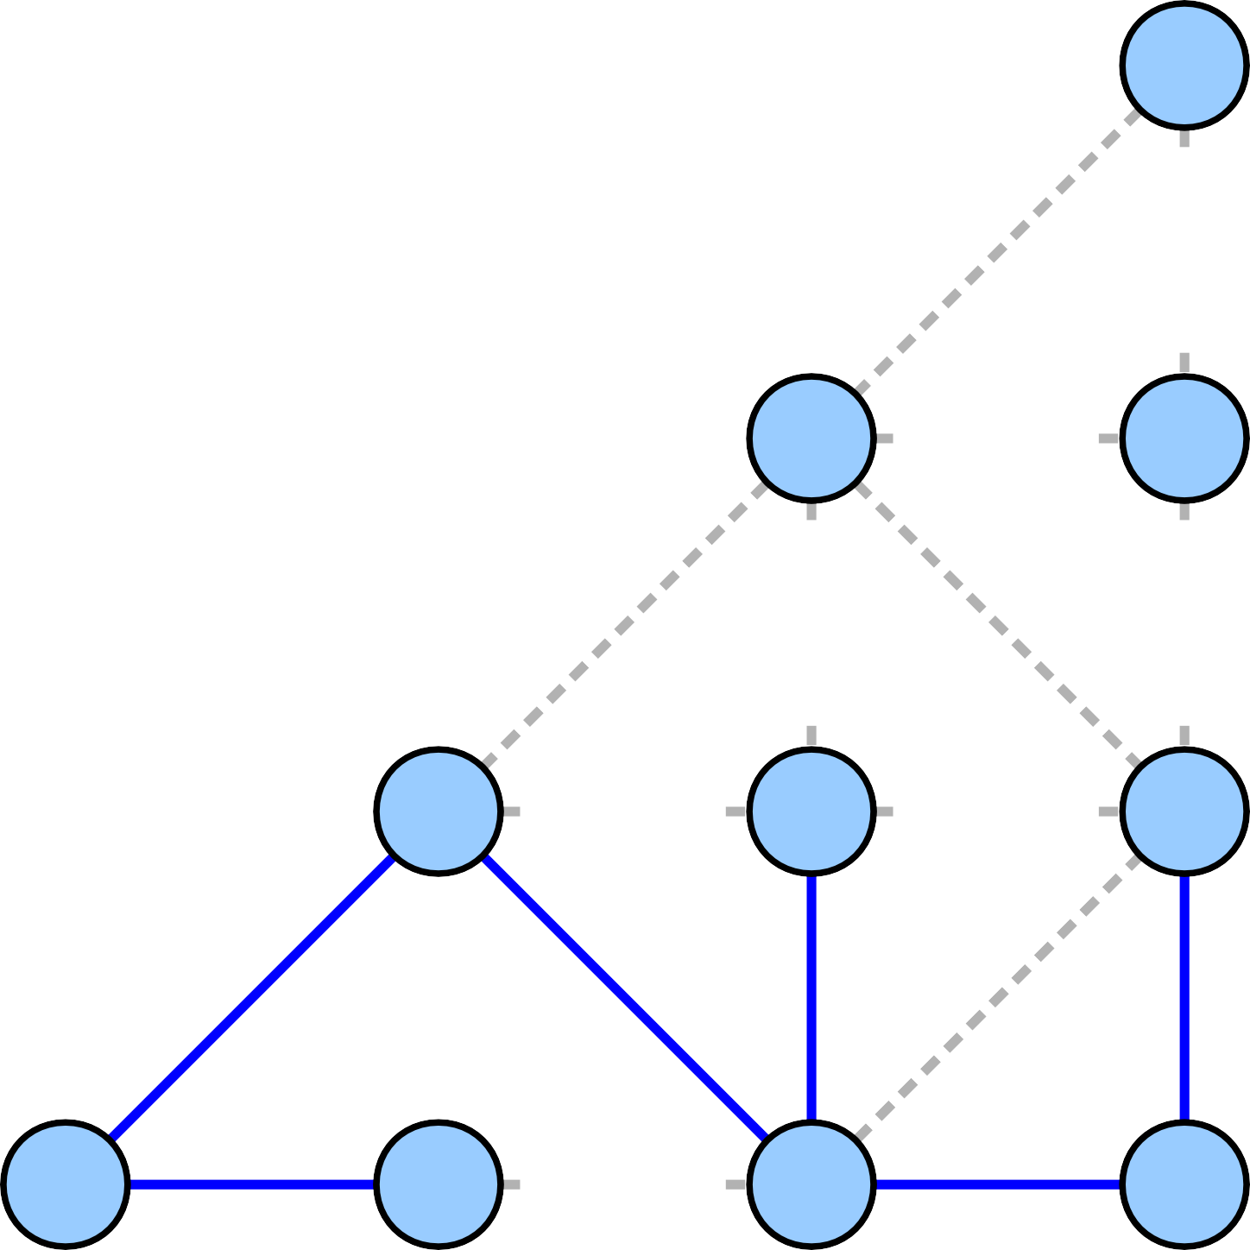
7
7
5
5
6
5
6
4
7
1
3
6
4
2
3
6
4

Slide 22

7
7
5
5
6
5
6
4
7
1
3
6
4
2
3
6
4

Slide 23
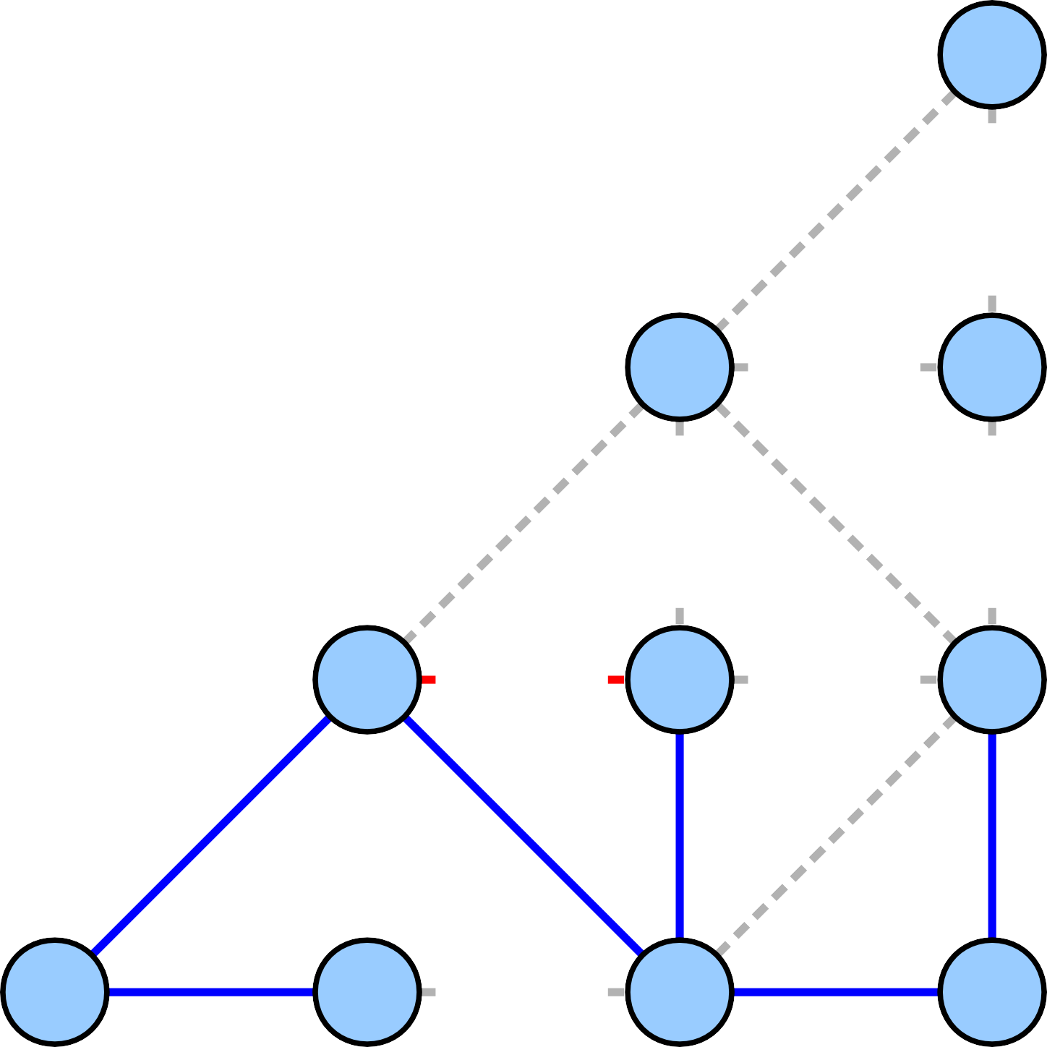
7
7
5
5
6
5
6
4
7
1
3
6
4
2
3
6
4

Slide 24
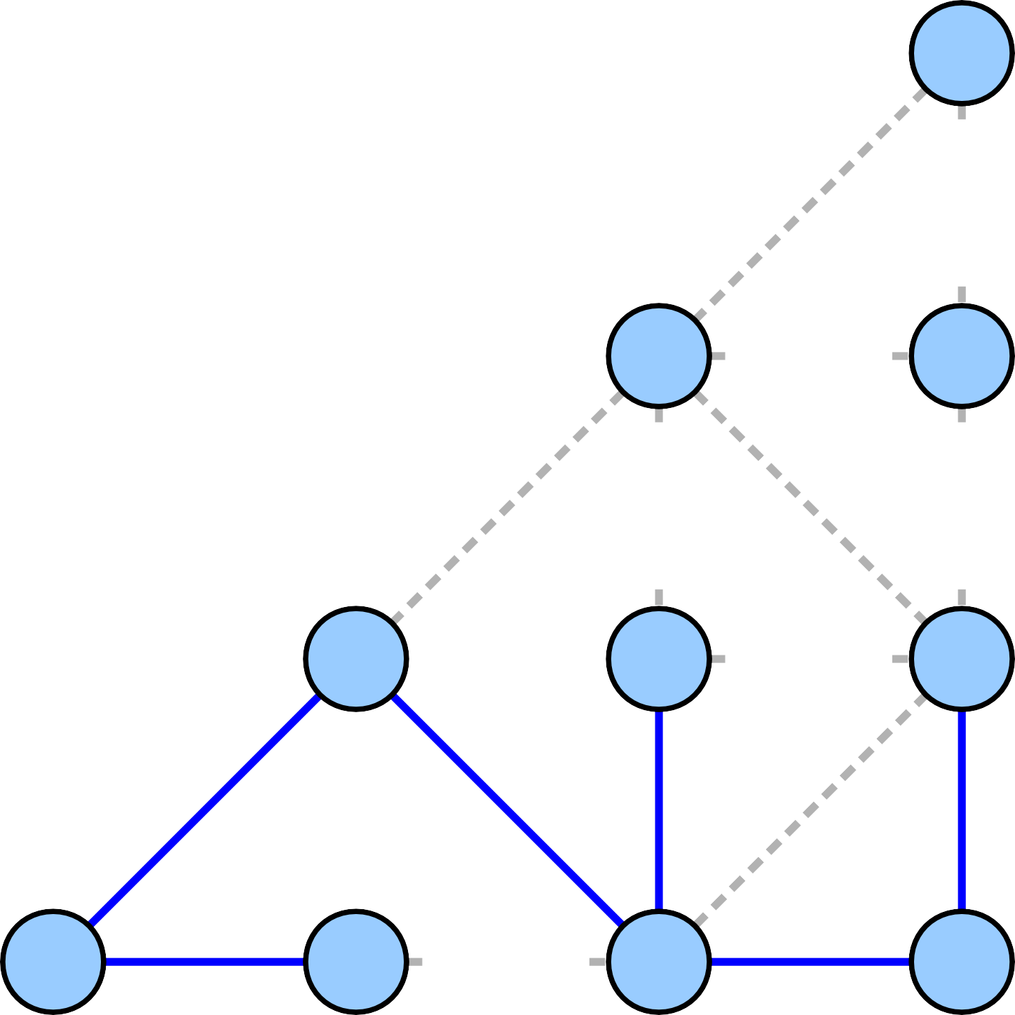
7
7
5
5
6
5
6
7
1
3
6
4
2
3
6
4

Slide 25
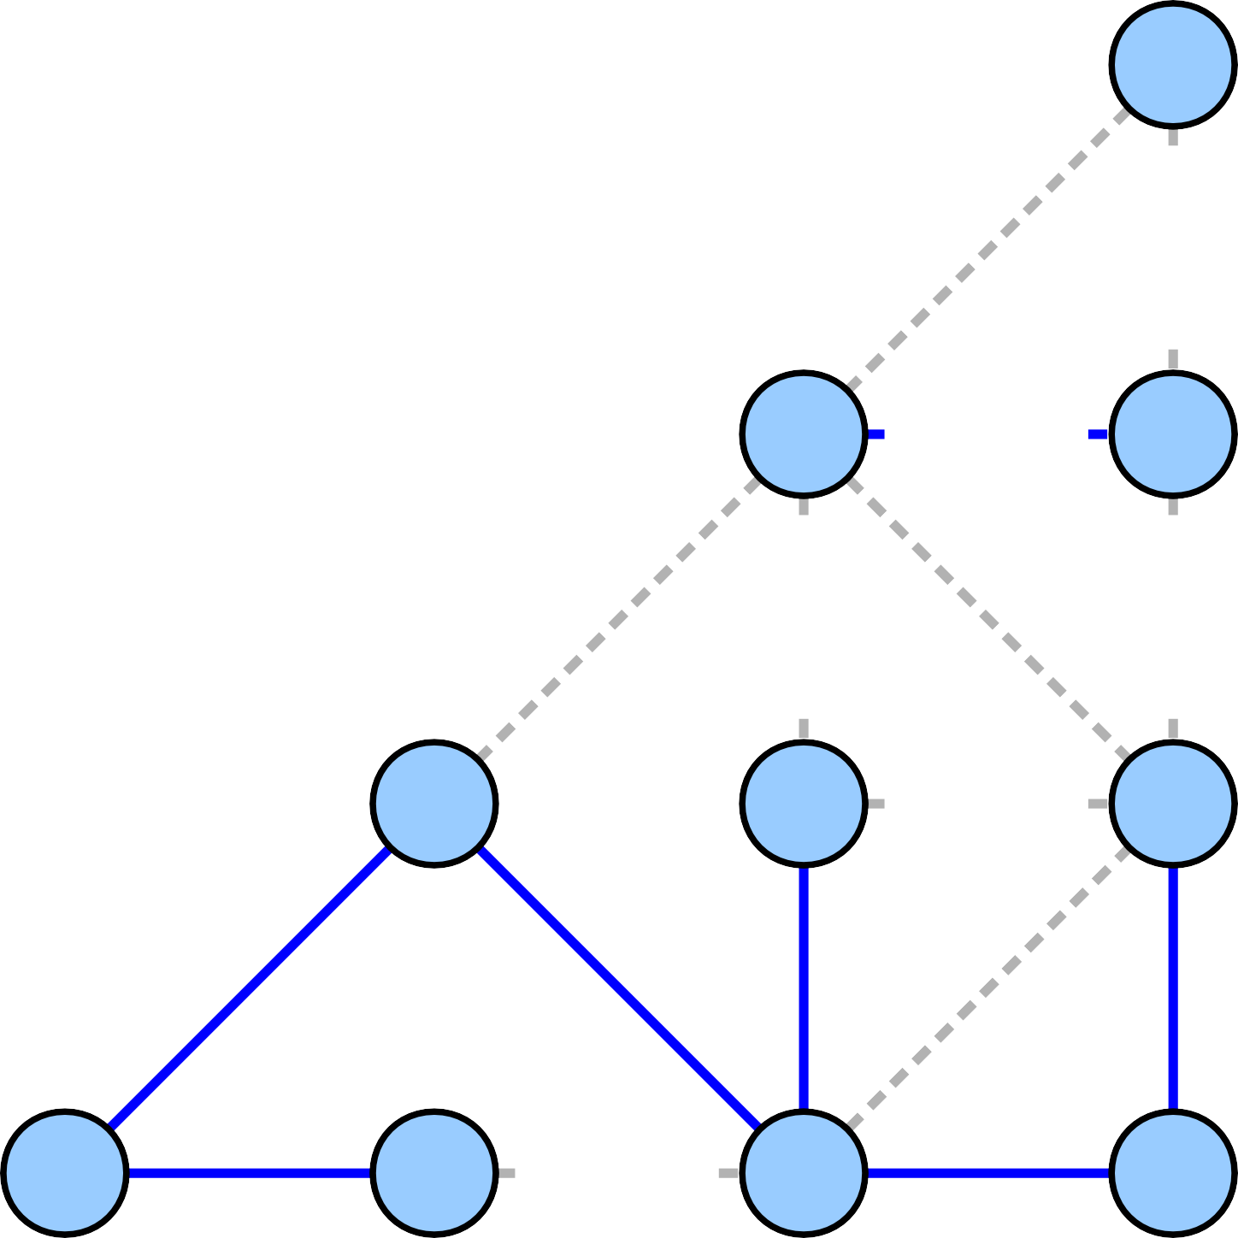
7
7
5
5
6
5
6
7
1
3
6
4
2
3
6
4

Slide 26
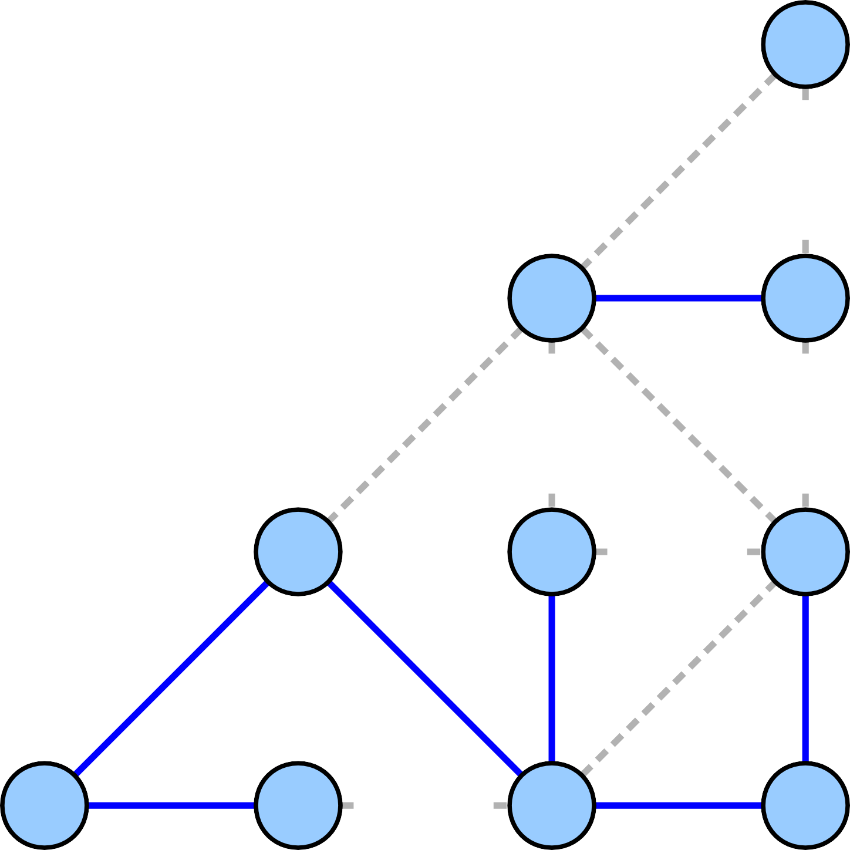
7
7
5
5
6
5
6
7
1
3
6
4
2
3
6
4

Slide 27
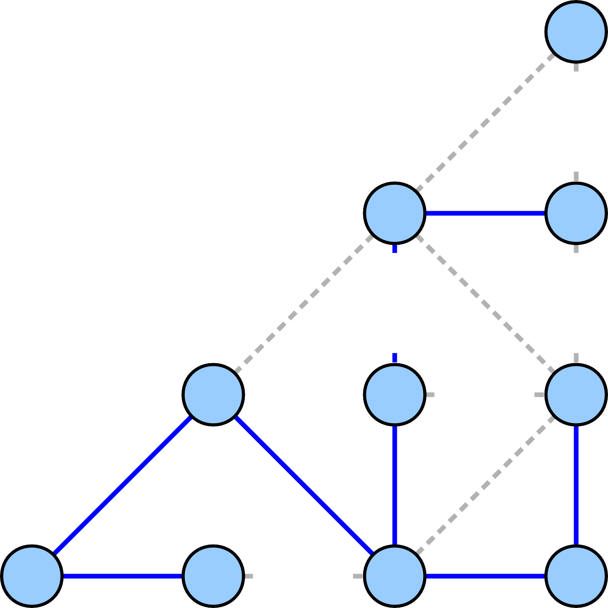
7
7
5
5
6
5
6
7
1
3
6
4
2
3
6
4

Slide 28
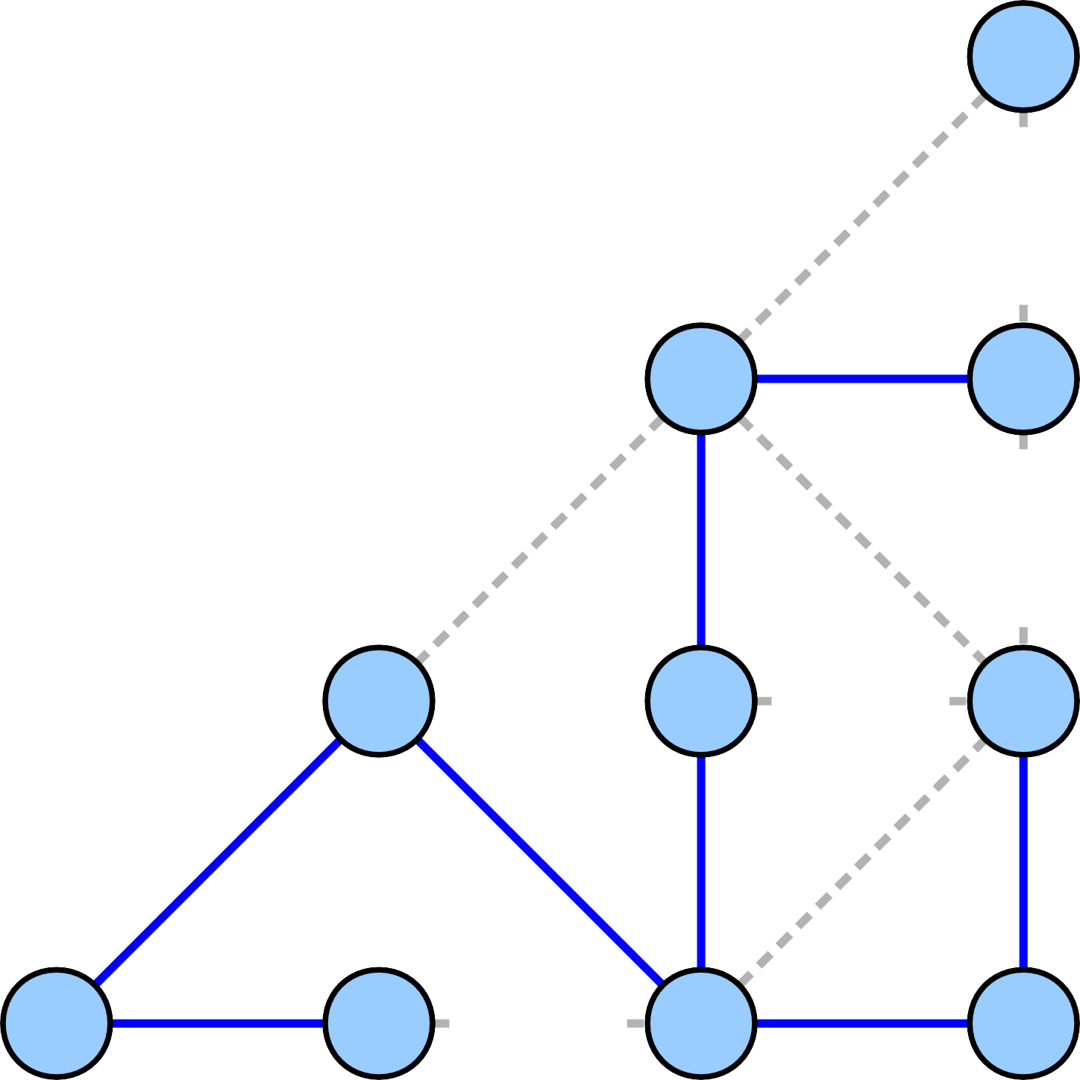
7
7
5
5
6
5
6
7
1
3
6
4
2
3
6
4

Slide 29
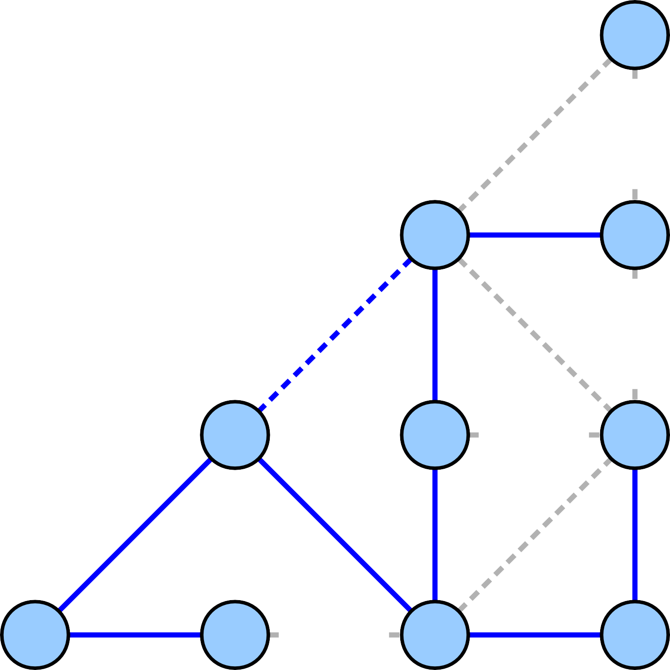
7
7
5
5
6
5
6
7
1
3
6
4
2
3
6
4

Slide 30
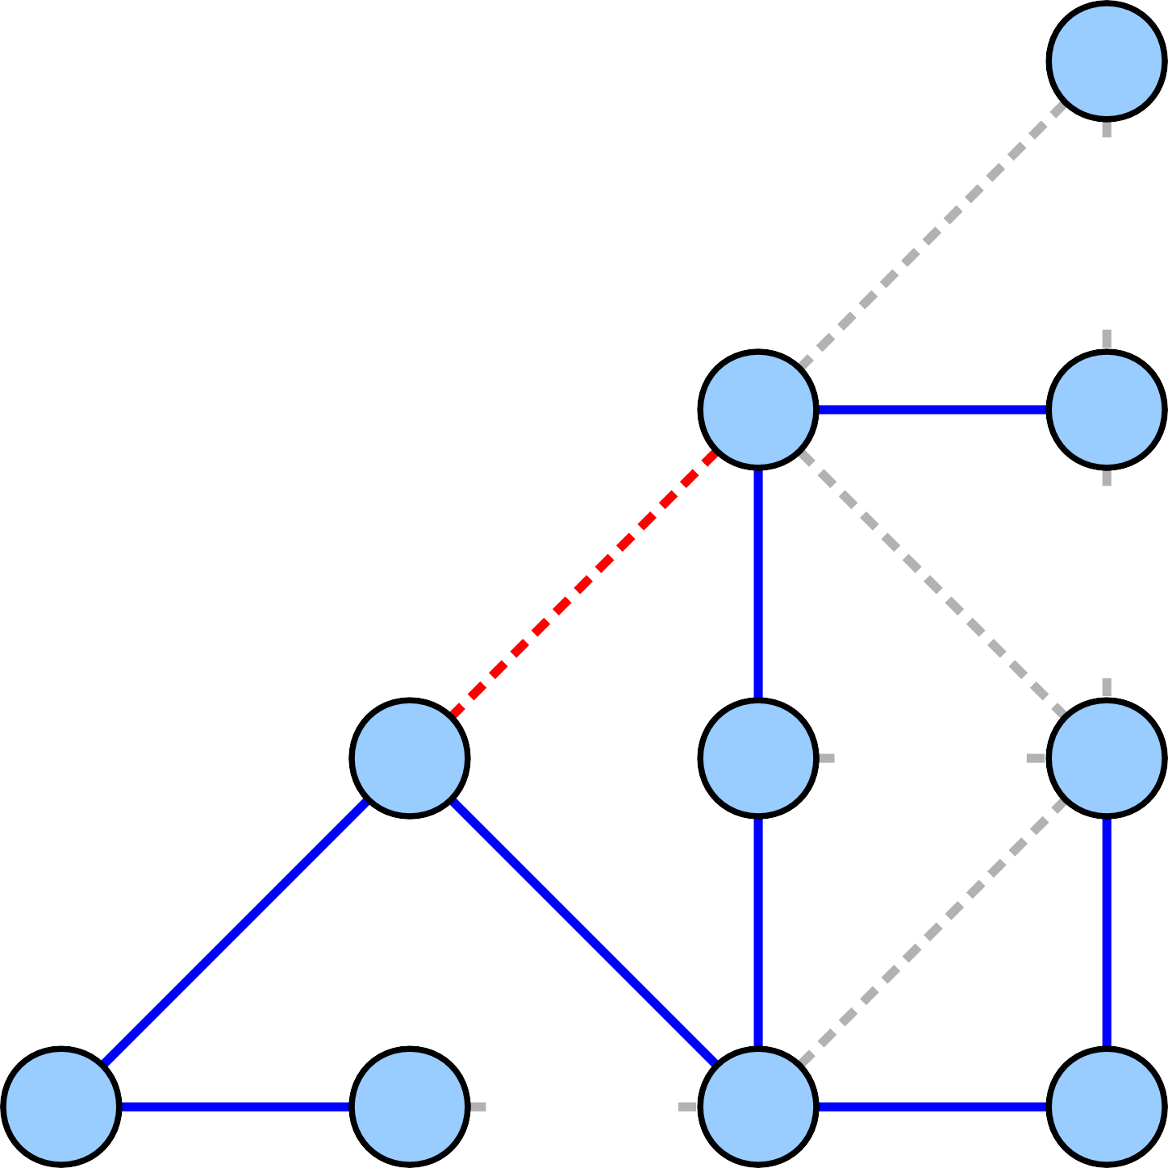
7
7
5
5
6
5
6
7
1
3
6
4
2
3
6
4

Slide 31

7
7
5
6
5
6
7
1
3
6
4
2
3
6
4

Slide 32
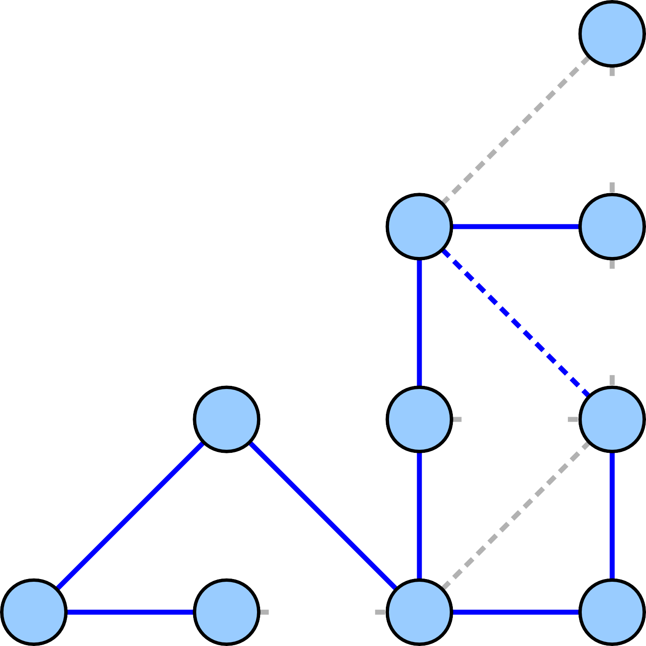
7
7
5
6
5
6
7
1
3
6
4
2
3
6
4

Slide 33
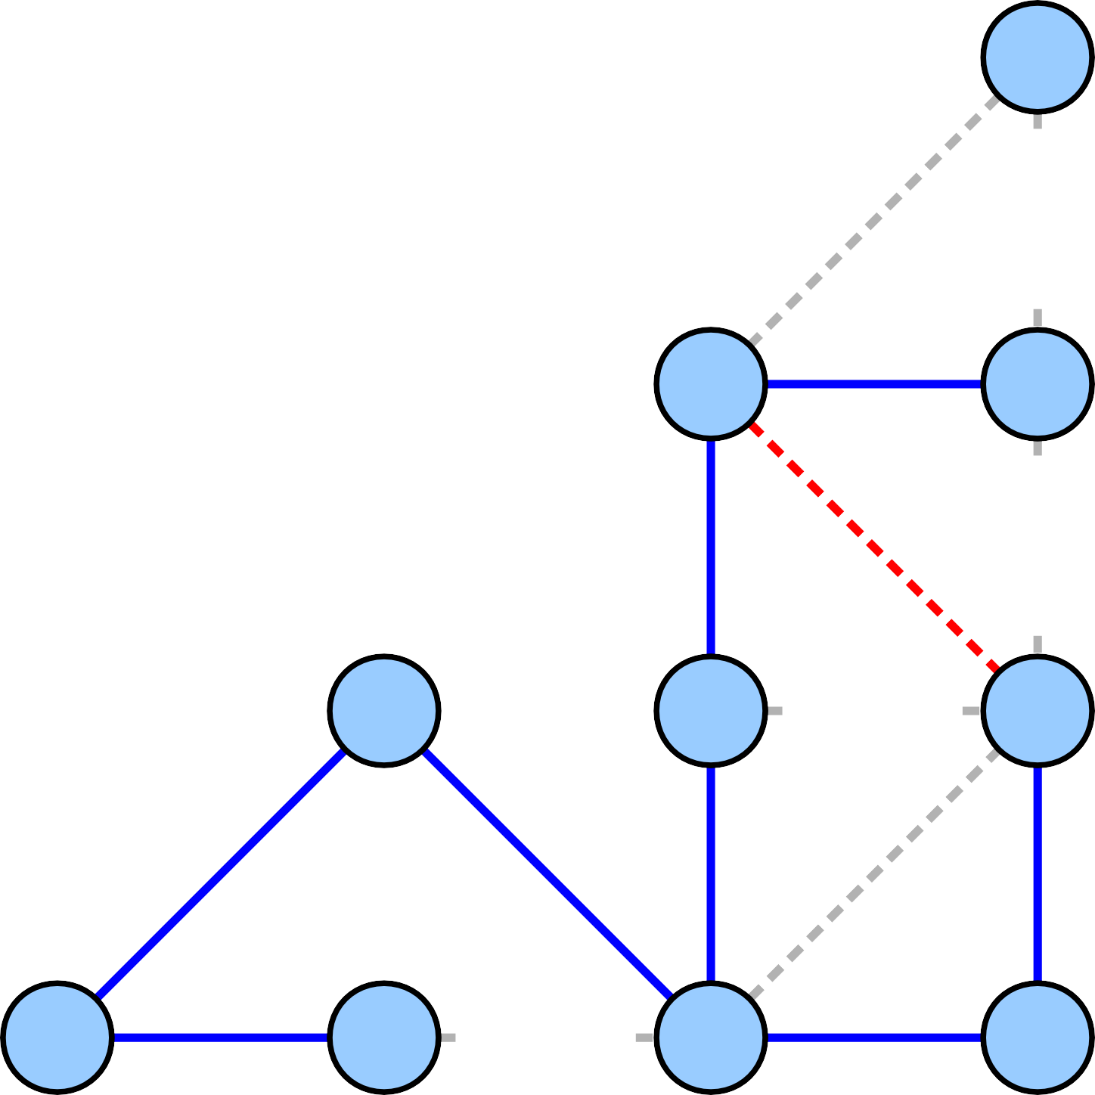
7
7
5
6
5
6
7
1
3
6
4
2
3
6
4

Slide 34

7
7
5
5
6
7
1
3
6
4
2
3
6
4

Slide 35

7
7
5
5
6
7
1
3
6
4
2
3
6
4

Slide 36

7
7
5
5
6
7
1
3
6
4
2
3
6
4

Slide 37

7
7
5
5
6
7
1
3
6
4
2
3
4

Slide 38

7
7
5
5
6
7
1
3
6
4
2
3
4

Slide 39

7
7
5
5
6
7
1
3
6
4
2
3
4

Slide 40
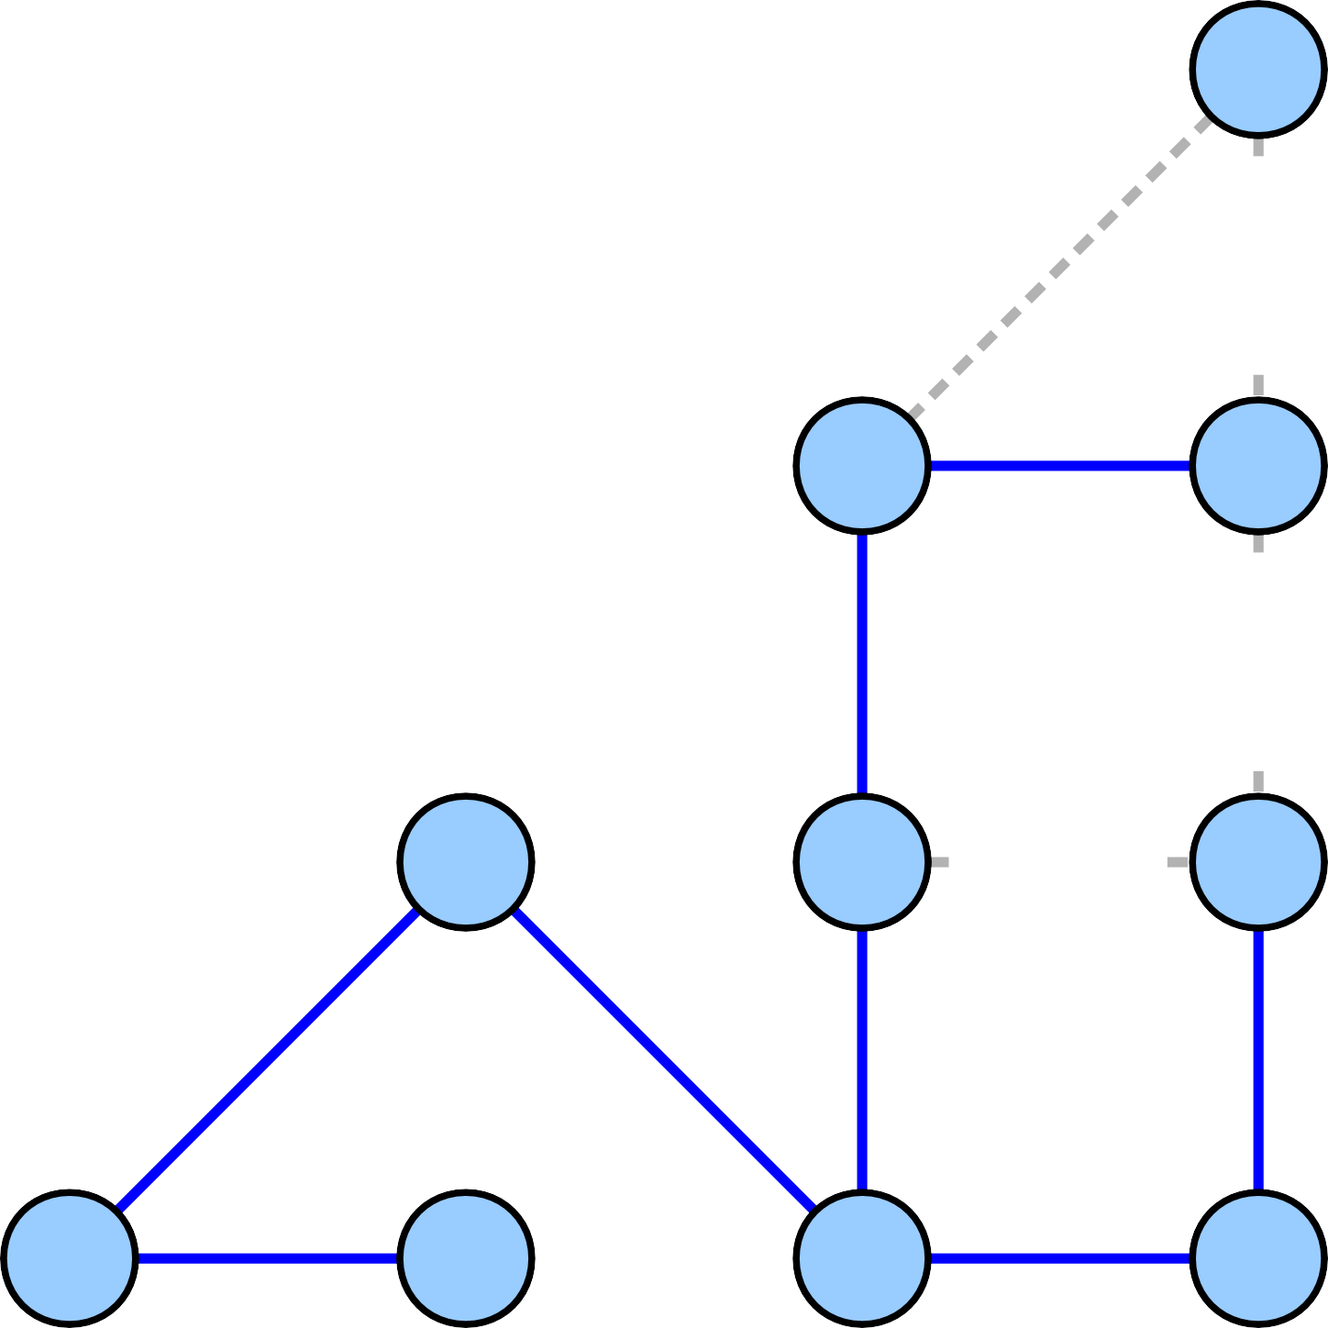
7
7
5
5
6
7
1
3
4
2
3
4

Slide 41

7
7
5
5
6
7
1
3
4
2
3
4

Slide 42
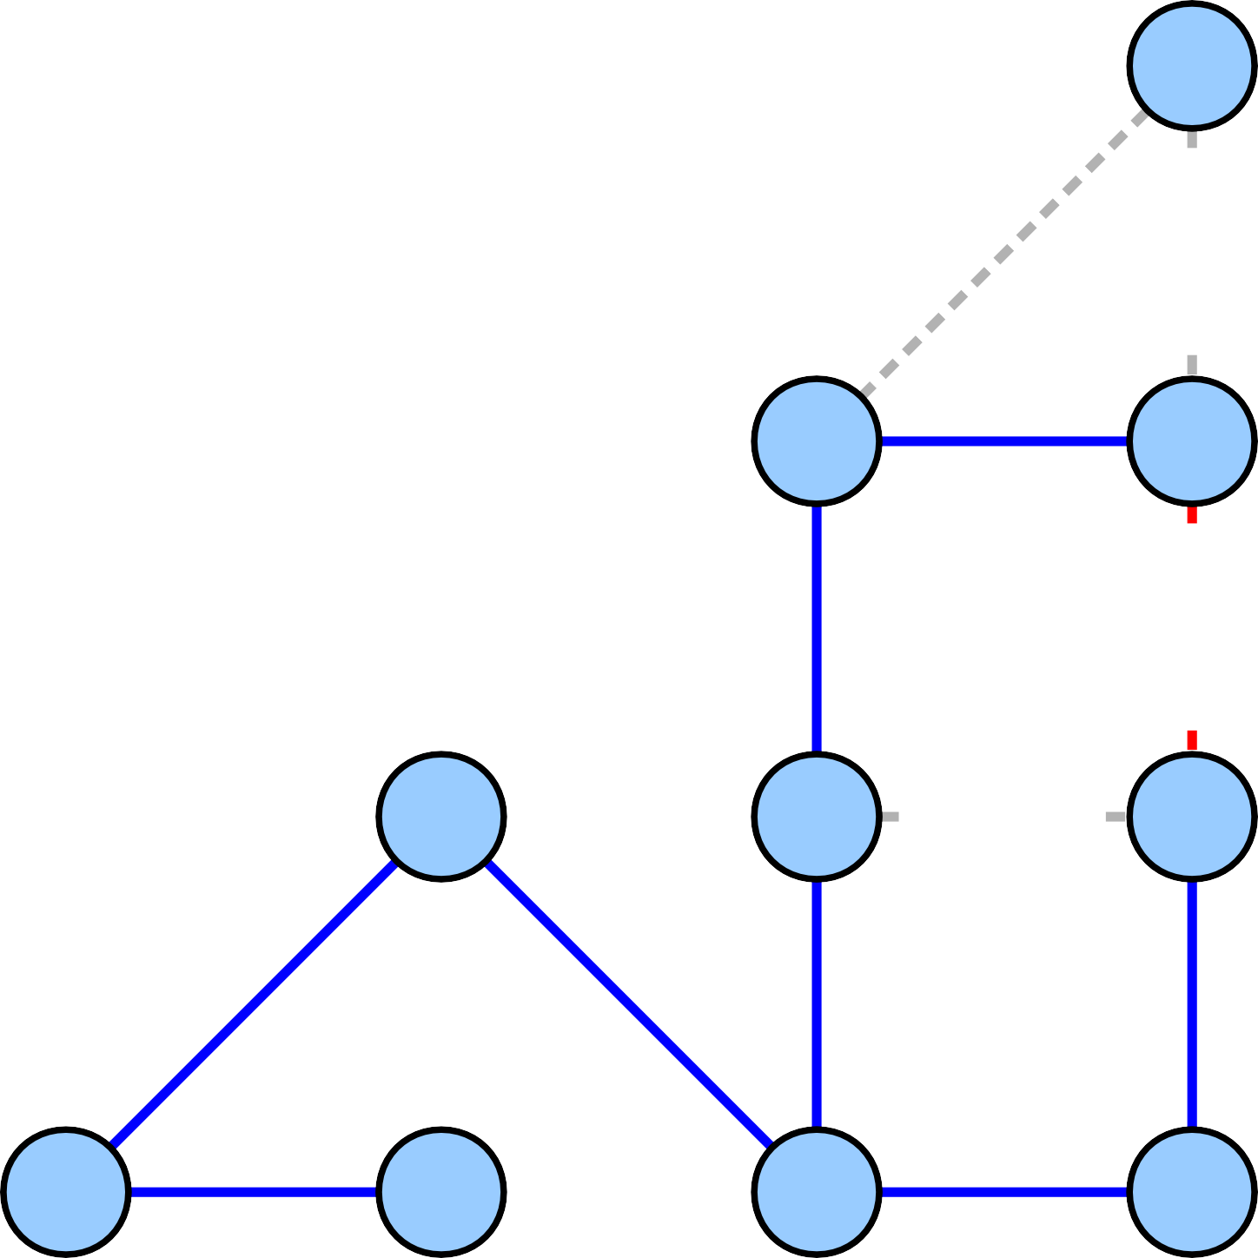
7
7
5
5
6
7
1
3
4
2
3
4

Slide 43
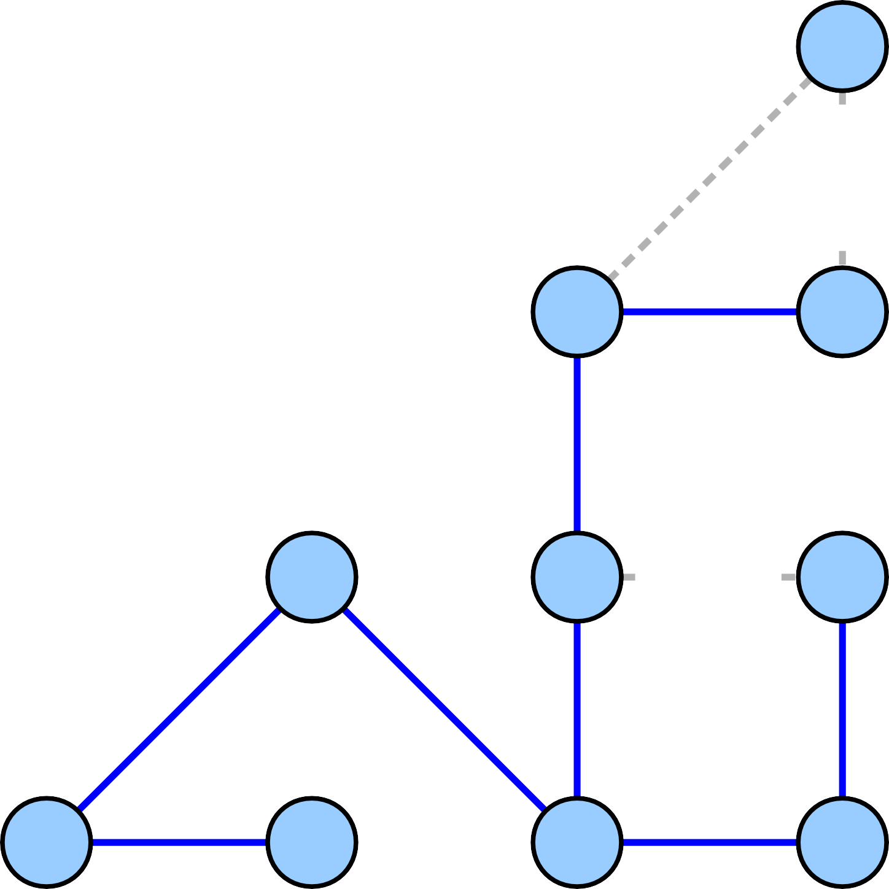
7
7
5
5
7
1
3
4
2
3
4

Slide 44

7
7
5
5
7
1
3
4
2
3
4

Slide 45

7
7
5
5
7
1
3
4
2
3
4

Slide 46
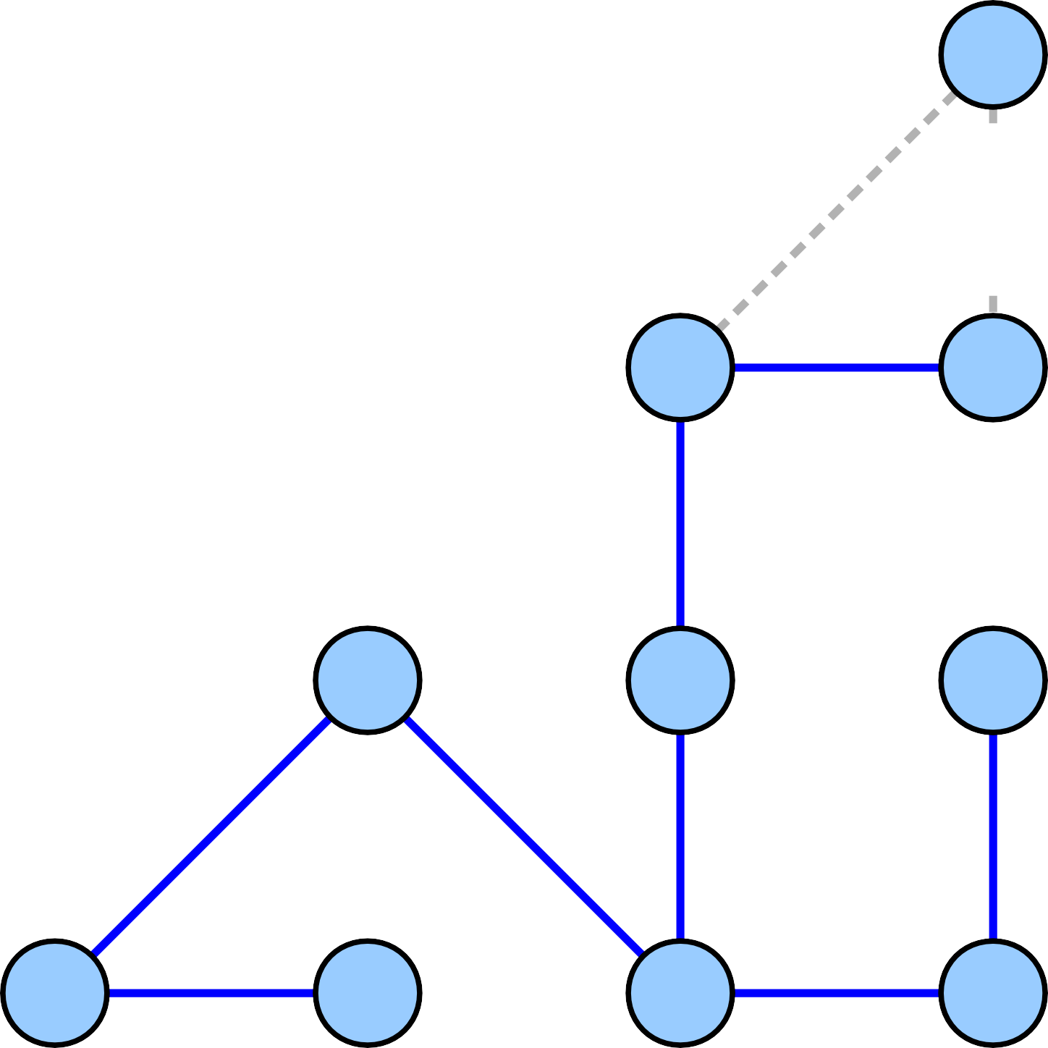
7
7
5
5
1
3
4
2
3
4

Slide 47
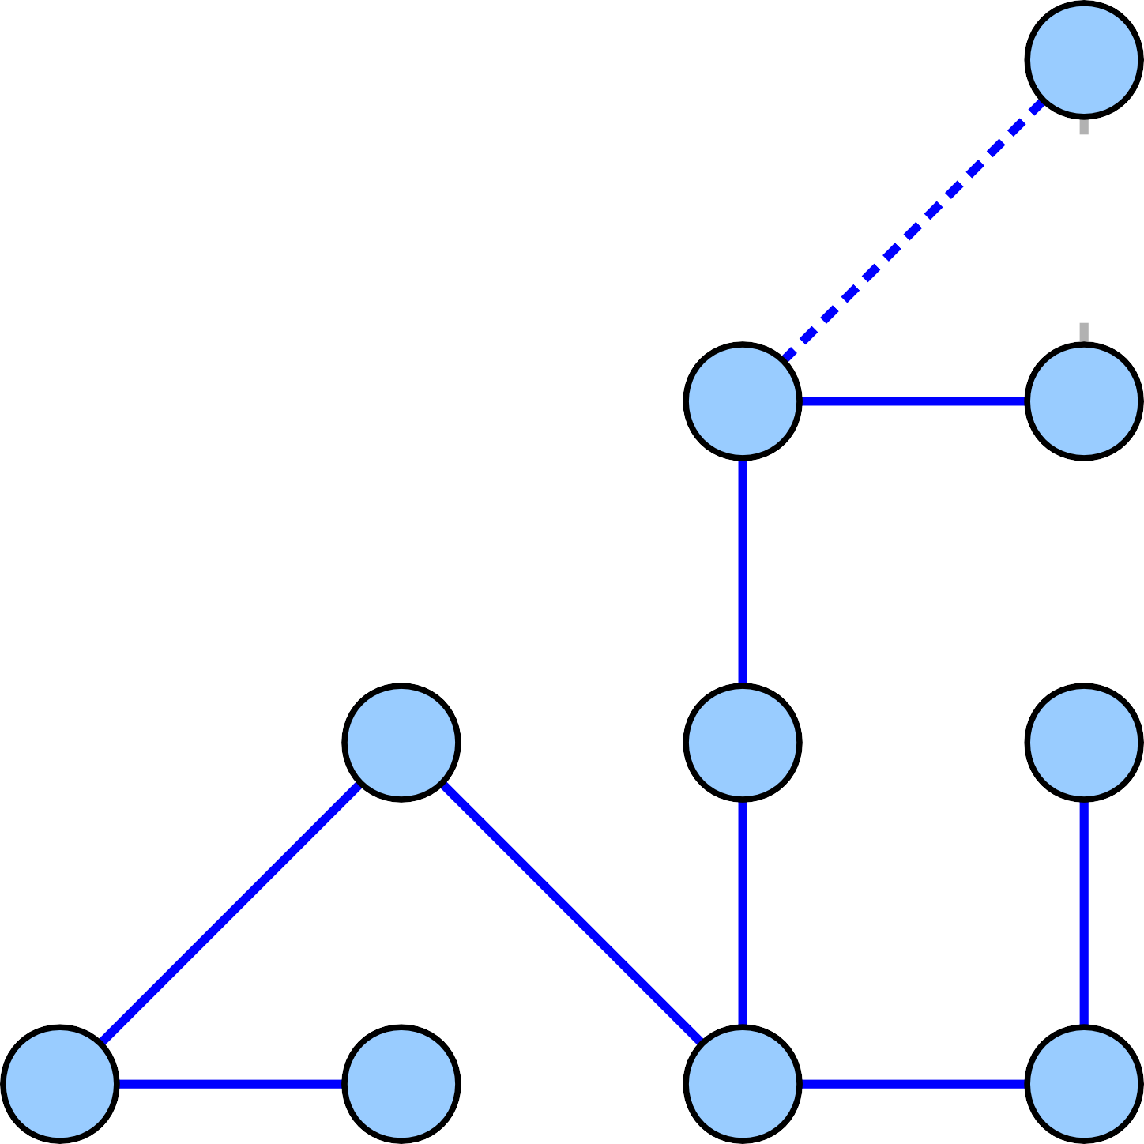
7
7
5
5
1
3
4
2
3
4

Slide 48
7
7
5
5
1
3
4
2
3
4

Slide 49
7
7
5
5
1
3
4
2
3
4

Slide 50
7
7
5
5
1
3
4
2
3
4

Slide 51
7
5
5
1
3
4
2
3
4

Slide 52
7
7
5
5
6
5
6
4
7
1
3
6
4
4
2
3
6
4

Slide 53
Showing Correctness
●
The correctness proof for Kruskal's algorithm uses an exchange argument similar to that for Prim's algorithm.
Recall: Prove Prim's algorithm is correct by looking at cuts in the graph:
●
●
Can swap an edge added by Prim's for a specially-chosen edge crossing some cut.
Since that edge is the lowest-cost edge crossing the cut, this cannot increase the cost.
●

Slide 54
1
2
1
2
3
1
3
1
2
2
1
2
2
1
1
4
1
4
2
3
2
3
2
4
2
4
1
1

Slide 55
1
2
1
2
3
1
3
1
2
2
1
2
2
1
1
4
1
4
2
3
2
3
2
4
2
4
1
1

Slide 56
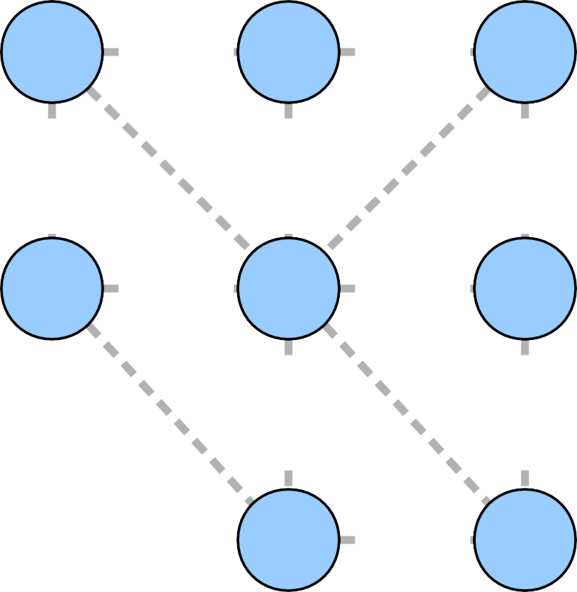
1
2
1
2
3
1
3
1
2
2
1
2
2
1
1
4
1
4
2
3
2
3
2
4
2
4
1
1

Slide 57
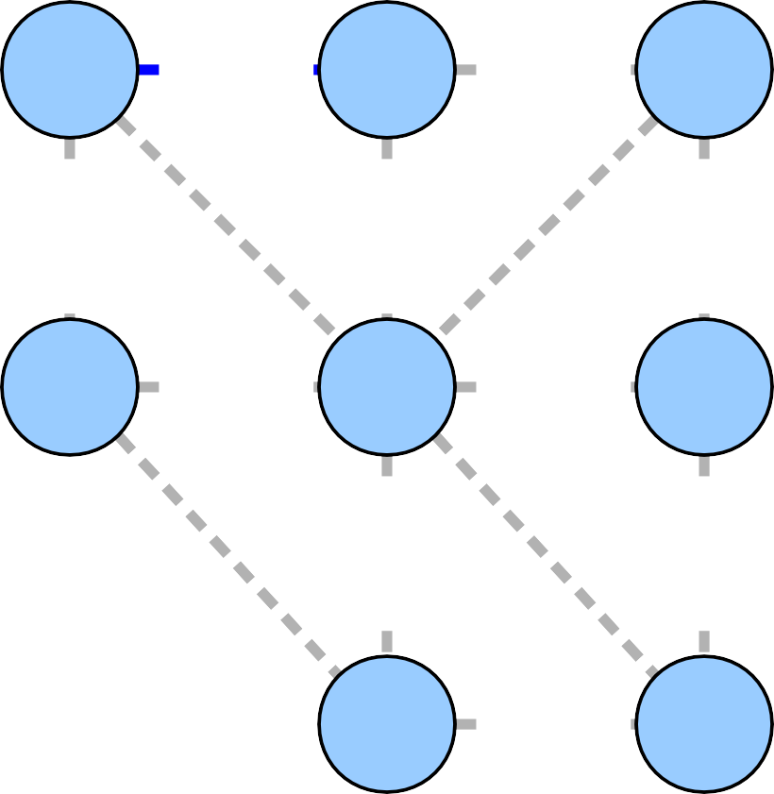
1
2
1
2
3
1
3
1
2
2
1
2
2
1
1
4
1
4
2
3
2
3
2
4
2
4
1
1

Slide 58
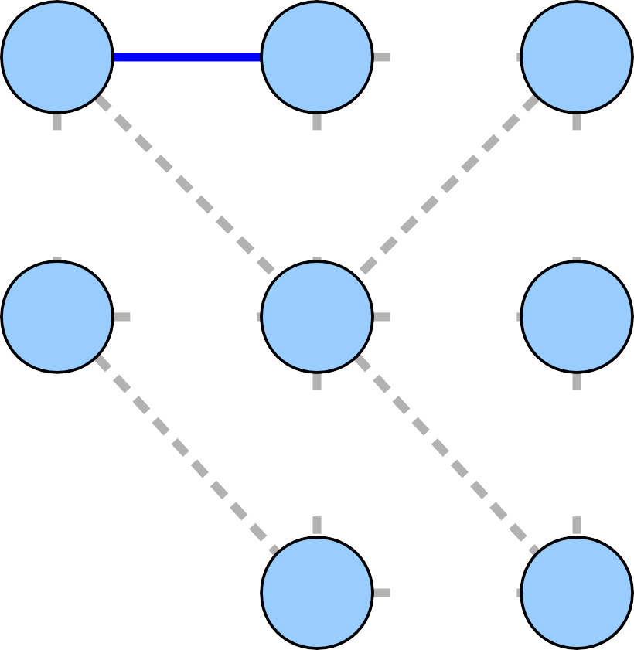
1
2
1
2
3
1
3
1
2
2
1
2
2
1
1
4
1
4
2
3
2
3
2
4
2
4
1
1

Slide 59
1
2
1
2
3
1
3
1
2
2
1
2
2
1
1
4
1
4
2
3
2
3
2
4
2
4
1
1

Slide 60
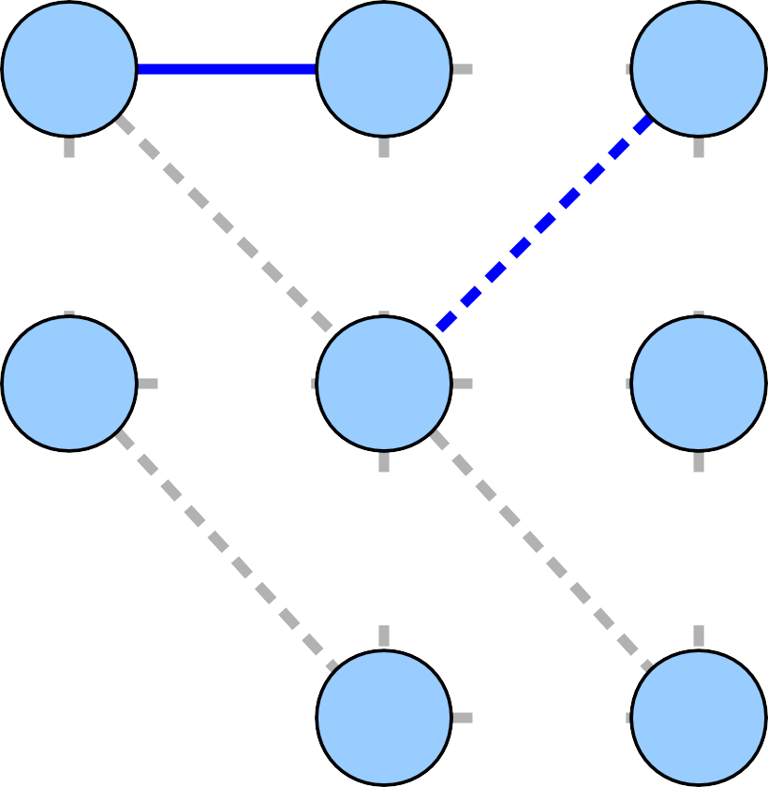
1
2
1
2
3
1
3
1
2
2
1
2
2
1
1
4
1
4
2
3
2
3
2
4
2
4
1
1

Slide 61
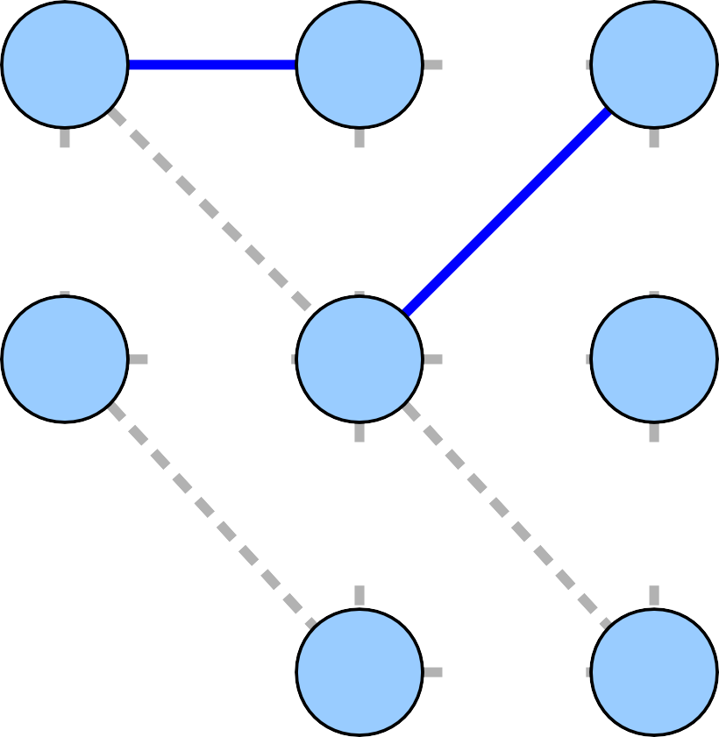
1
2
1
2
3
1
3
1
2
2
1
2
2
1
1
4
1
4
2
3
2
3
2
4
2
4
1
1

Slide 62
1
2
1
2
3
1
3
1
2
2
1
2
2
1
1
4
1
4
2
3
2
3
2
4
2
4
1
1

Slide 63

1
2
1
2
3
1
3
1
2
2
1
2
2
1
1
4
1
4
2
3
2
3
2
4
2
4
1
1

Slide 64
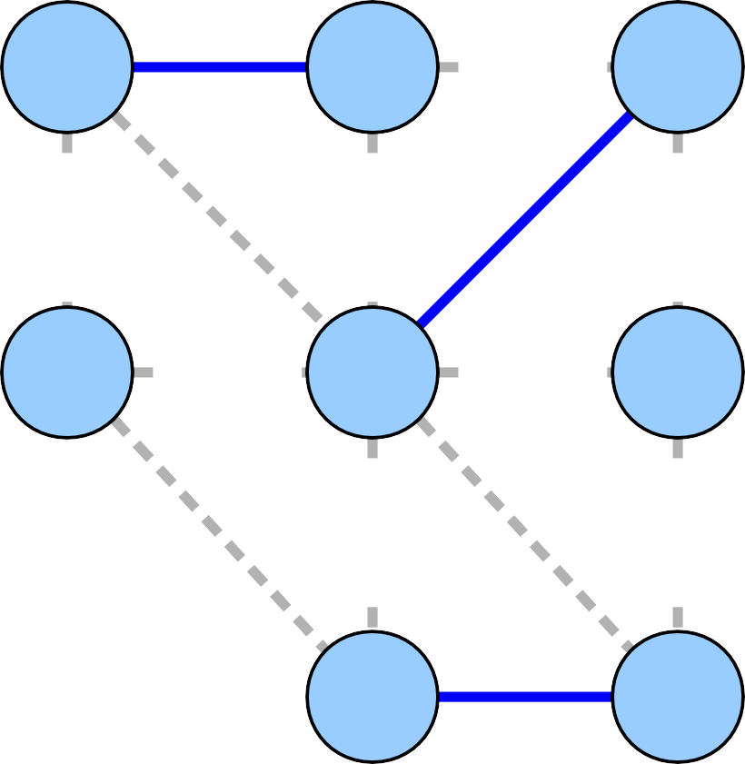
1
2
1
2
3
1
3
1
2
2
1
2
2
1
1
4
1
4
2
3
2
3
2
4
2
4
1
1

Slide 65
1
2
1
2
3
1
3
1
2
2
1
2
2
1
1
4
1
4
2
3
2
3
2
4
2
4
1
1

Slide 66

1
2
1
2
3
1
3
1
2
2
1
2
2
1
1
4
1
4
2
3
2
3
2
4
2
4
1
1

Slide 67
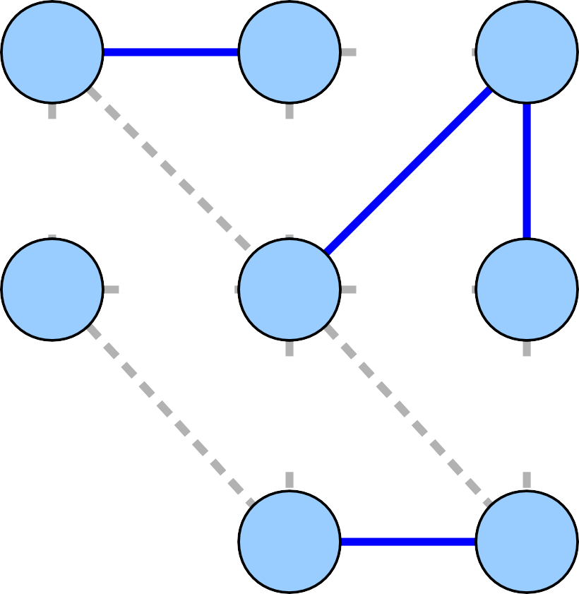
1
2
1
2
3
1
3
1
2
2
1
2
2
1
1
4
1
4
2
3
2
3
2
4
2
4
1
1

Slide 68
1
2
1
2
3
1
3
1
2
2
1
2
2
1
1
4
1
4
2
3
2
3
2
4
2
4
1
1

Slide 69

1
2
1
2
3
1
3
1
2
2
1
2
2
1
1
4
1
4
2
3
2
3
2
4
2
4
1
1

Slide 70

1
2
1
2
3
1
3
1
2
2
1
2
2
1
1
4
1
4
2
3
2
3
2
4
2
4
1
1

Slide 71
1
2
1
2
3
1
3
1
2
2
1
2
2
1
1
4
1
4
2
3
2
3
2
4
2
4
1
1

Slide 72

1
2
1
2
3
1
3
1
2
2
1
2
2
1
1
4
1
4
2
3
2
3
2
4
2
4
1
1

Slide 73
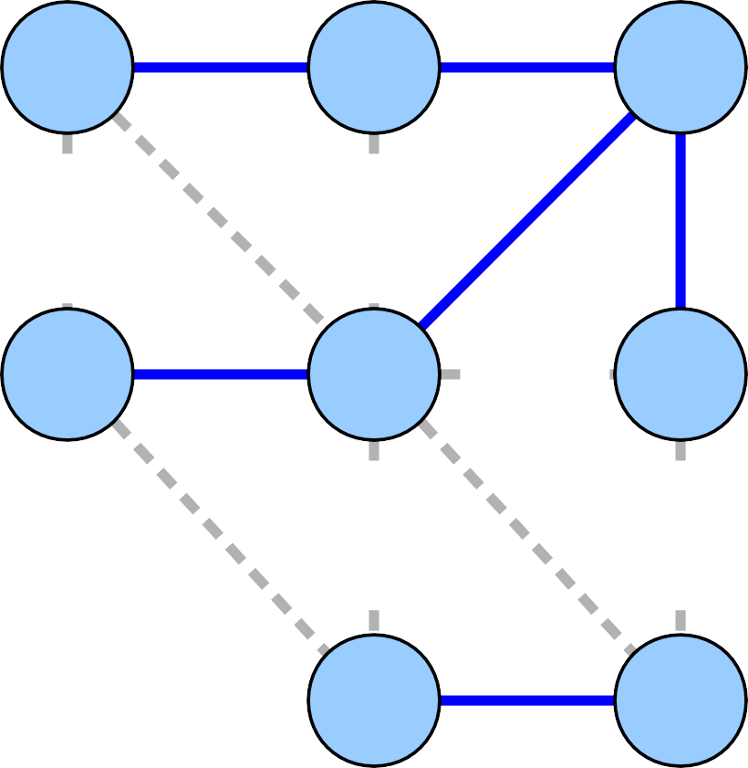
1
2
1
2
3
1
3
1
2
2
1
2
2
1
1
4
1
4
2
3
2
3
2
4
2
4
1
1

Slide 74
1
2
1
2
3
1
3
1
2
2
1
2
2
1
1
4
1
4
2
3
2
3
2
4
2
4
1
1

Slide 75
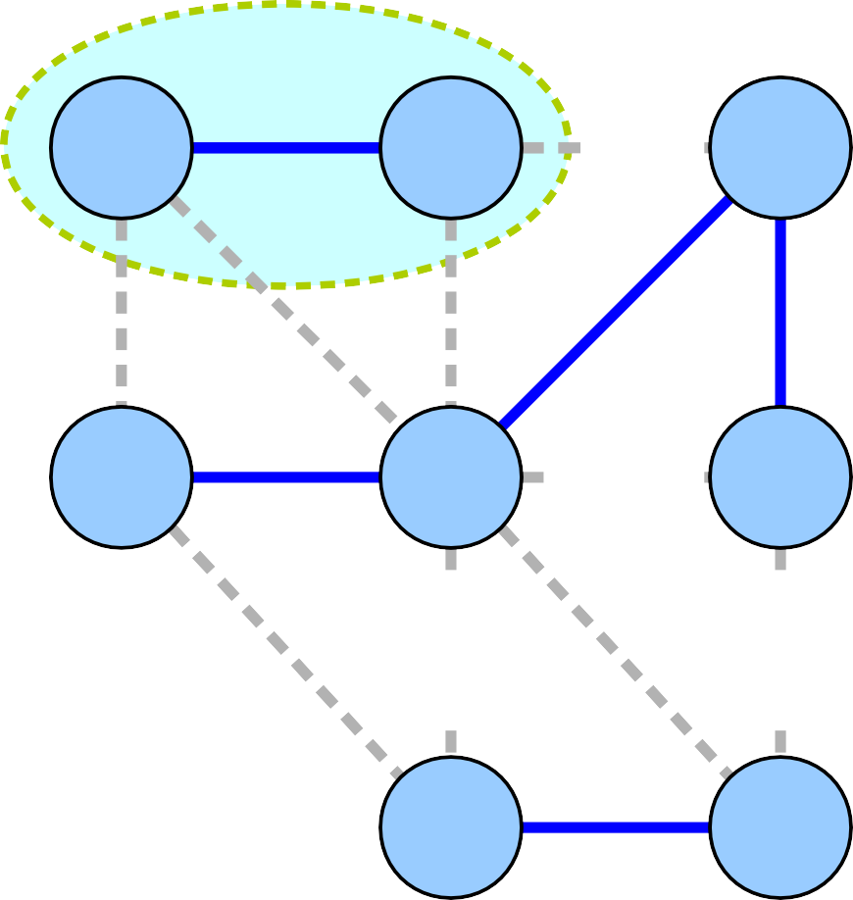
1
2
1
2
3
1
3
1
2
2
1
2
2
1
1
4
1
4
2
3
2
3
2
4
2
4
1
1

Slide 76
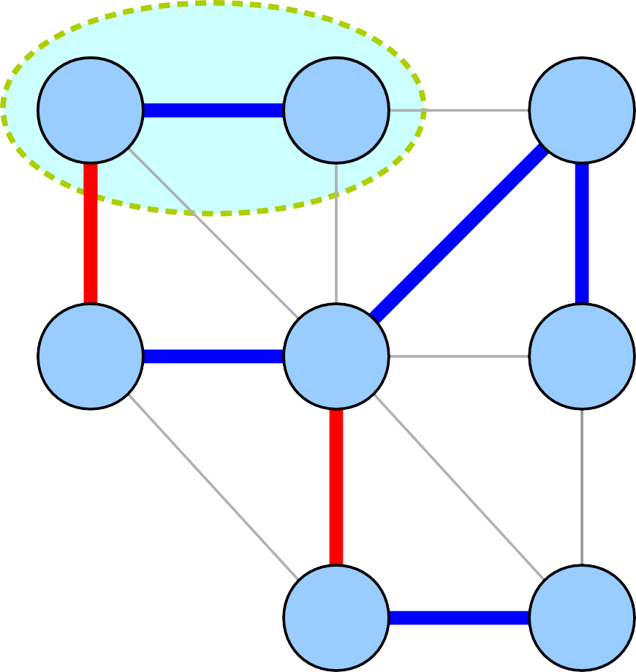
1
2
1
2
3
1
3
1
2
2
1
2
2
1
1
4
1
4
2
3
2
3
2
4
2
4
1
1

Slide 77
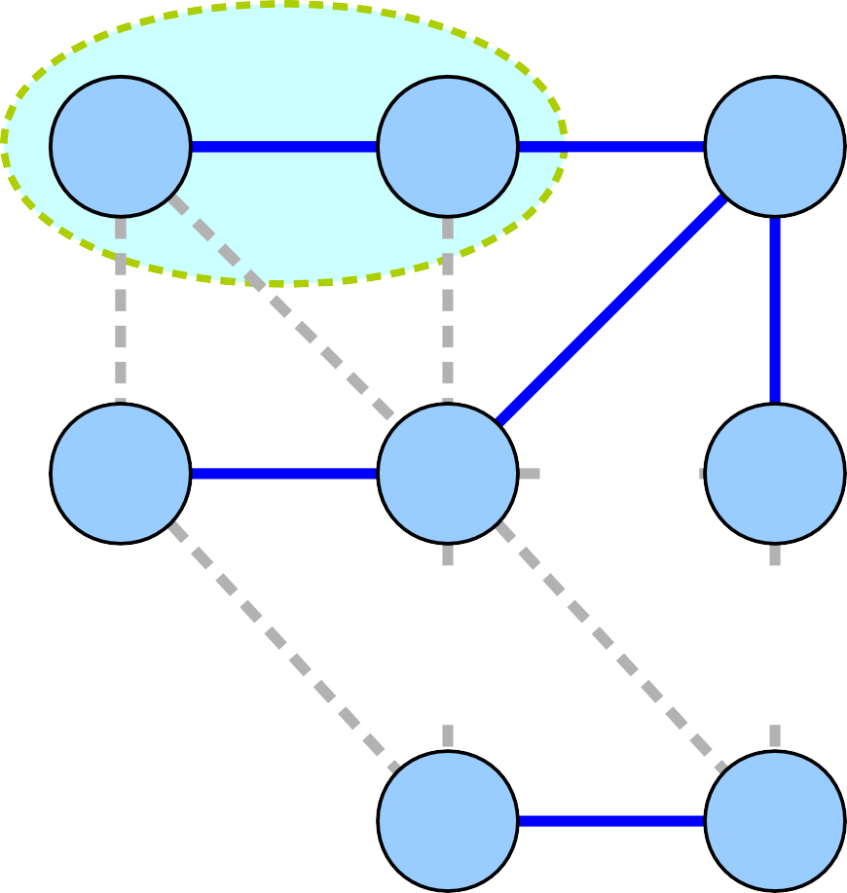
1
2
1
2
3
1
3
1
2
2
1
2
2
1
1
4
1
4
2
3
2
3
2
4
2
4
1
1

Slide 78
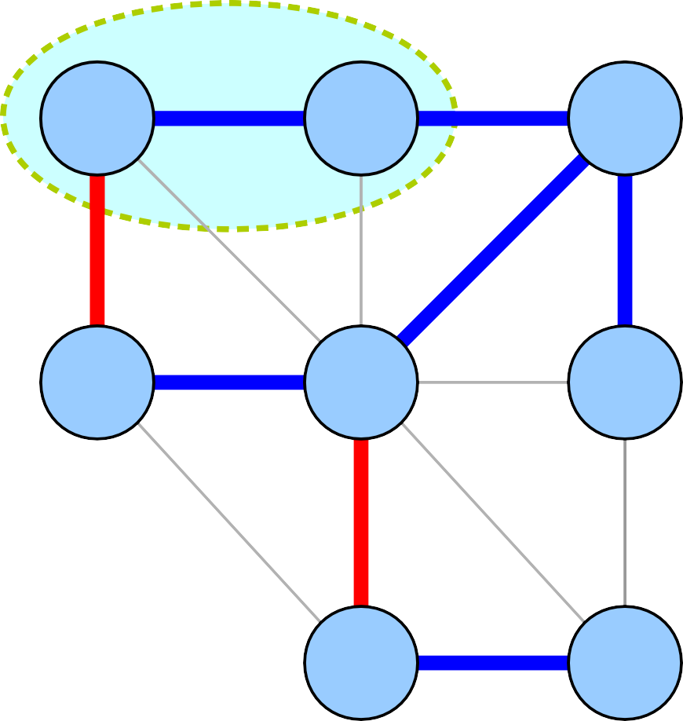
1
2
1
2
3
1
3
1
2
2
1
2
2
1
1
4
1
4
2
3
2
3
2
4
2
4
1
1

Slide 79
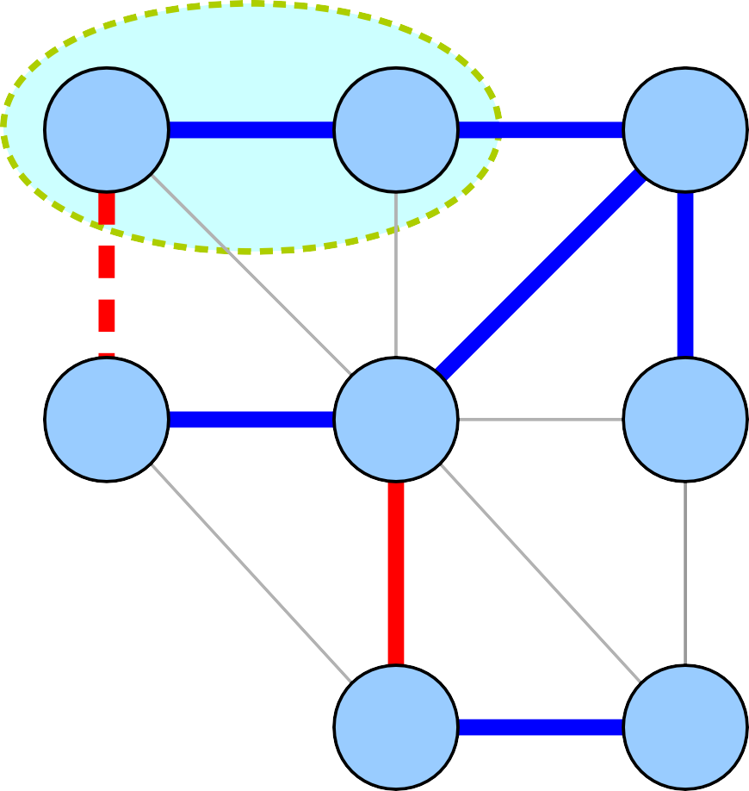
1
2
1
2
3
1
3
1
2
2
1
2
2
1
1
4
1
4
2
3
2
3
2
4
2
4
1
1

Slide 80
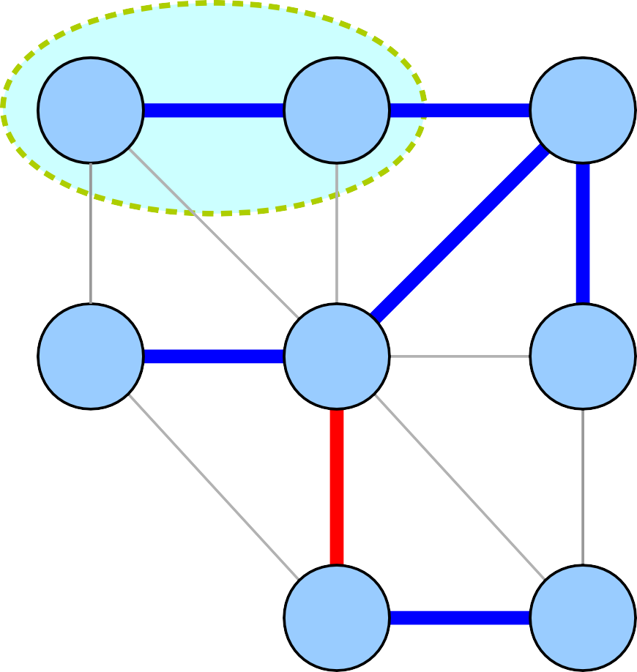
1
2
1
2
3
1
3
1
2
2
1
2
2
1
1
4
1
4
2
3
2
3
2
4
2
4
1
1

Slide 81
1
2
1
2
3
1
3
1
2
2
1
2
2
1
1
4
1
4
2
3
2
3
2
4
2
4
1
1

Slide 82
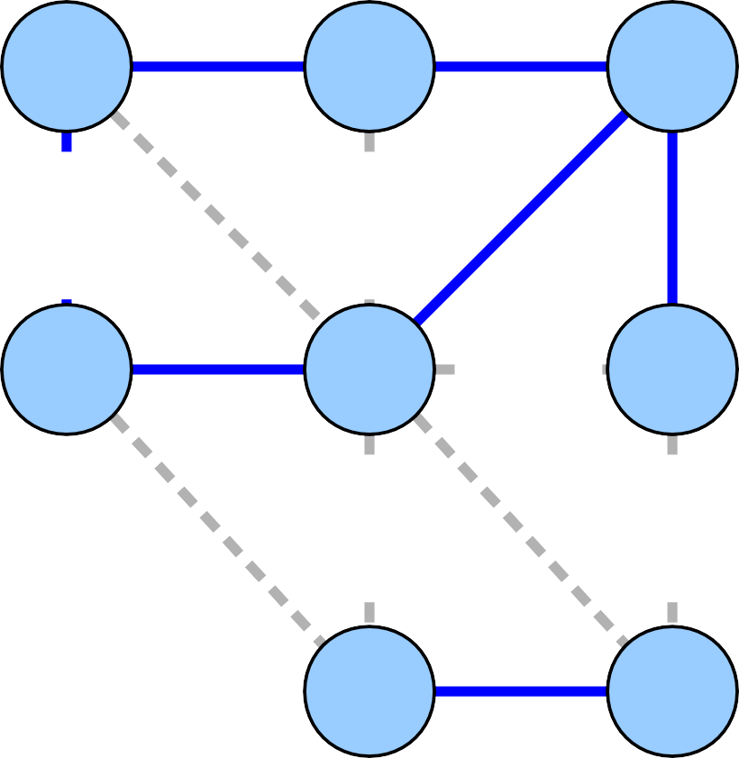
1
2
1
2
3
1
3
1
2
2
1
2
2
1
1
4
1
4
2
3
2
3
2
4
2
4
1
1

Slide 83
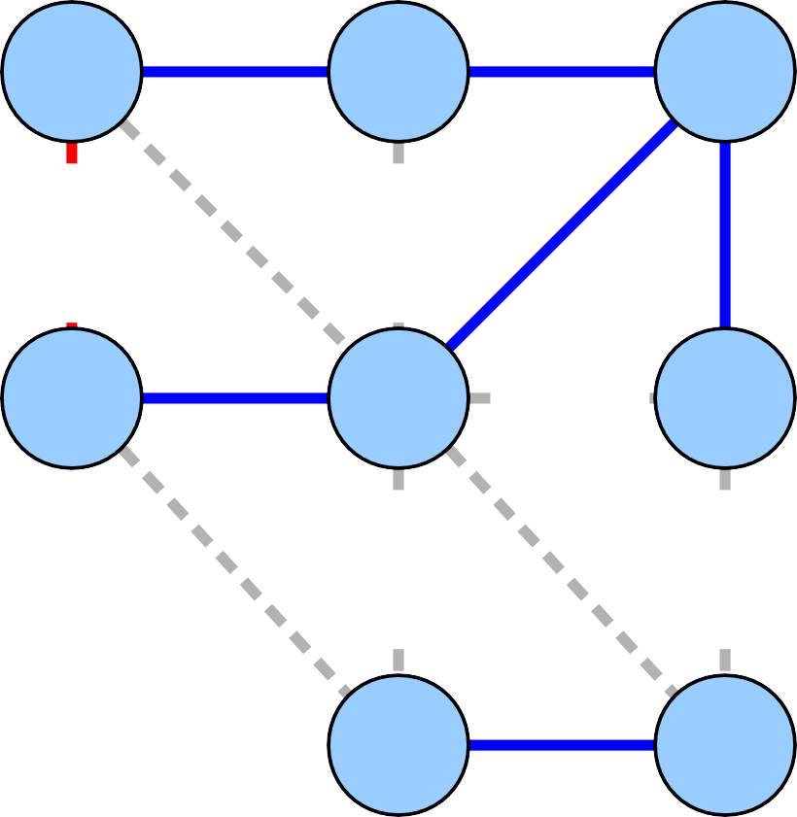
1
2
1
2
3
1
3
1
2
2
1
2
2
1
1
4
1
4
2
3
2
3
2
4
2
4
1
1

Slide 84

1
2
1
2
3
1
3
1
2
1
2
2
1
1
4
1
4
2
3
2
3
2
4
2
4
1
1

Slide 85
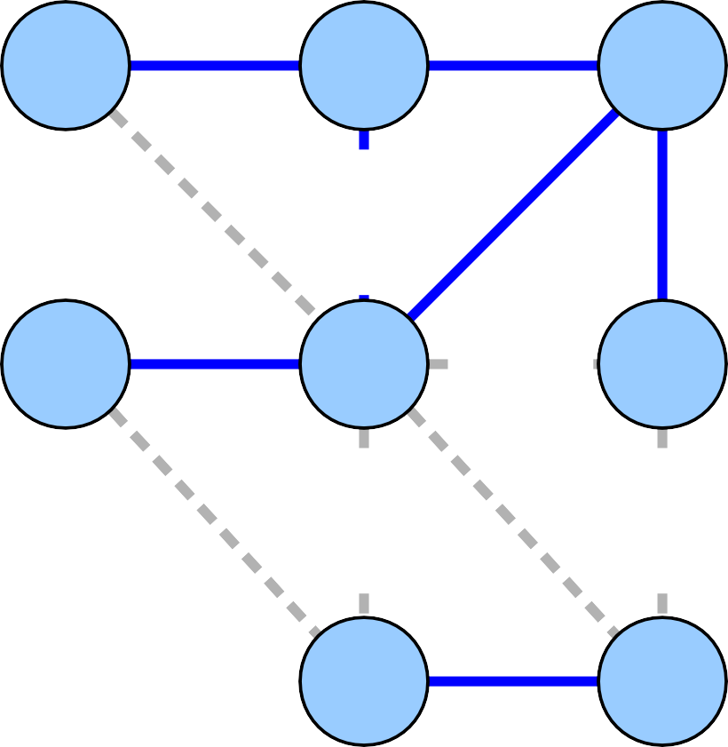
1
2
1
2
3
1
3
1
2
1
2
2
1
1
4
1
4
2
3
2
3
2
4
2
4
1
1

Slide 86
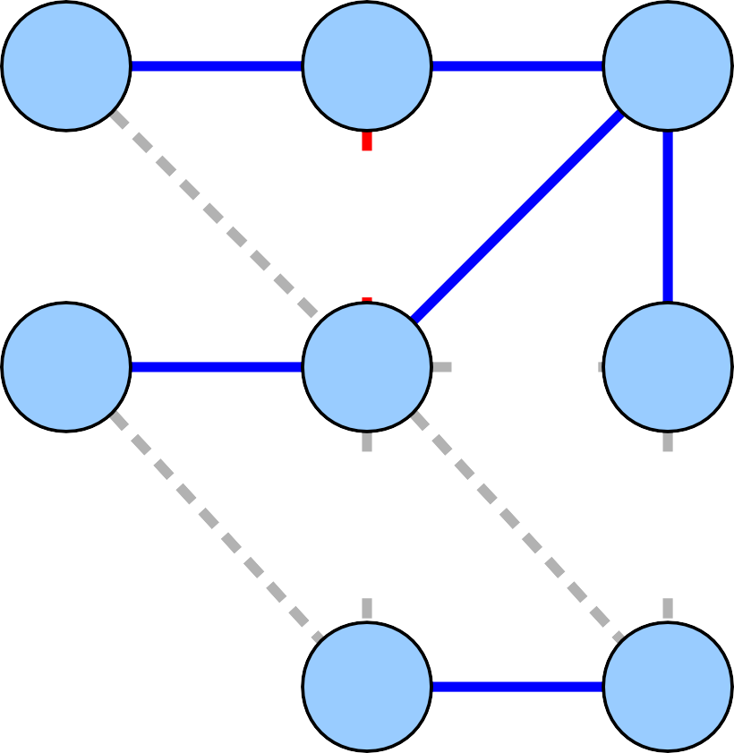
1
2
1
2
3
1
3
1
2
1
2
2
1
1
4
1
4
2
3
2
3
2
4
2
4
1
1

Slide 87

1
2
1
2
3
1
3
1
1
2
2
1
1
4
1
4
2
3
2
3
2
4
2
4
1
1

Slide 88
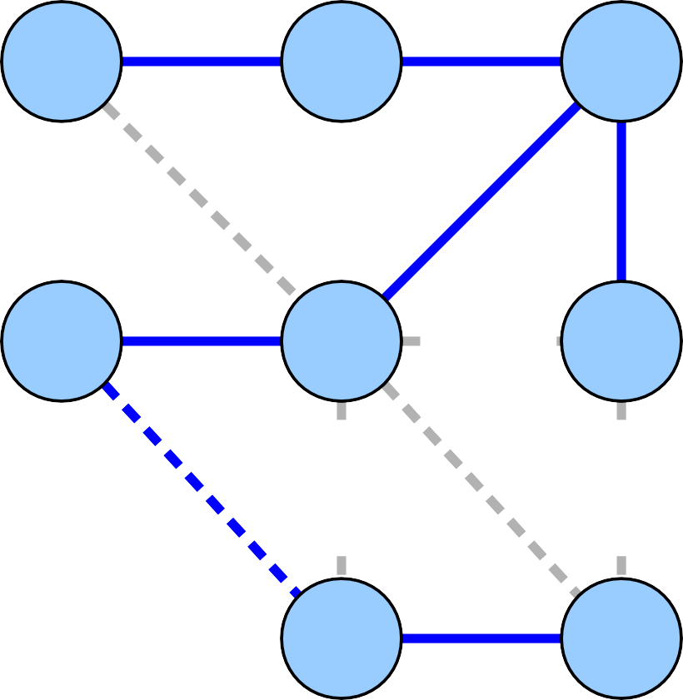
1
2
1
2
3
1
3
1
1
2
2
1
1
4
1
4
2
3
2
3
2
4
2
4
1
1

Slide 89
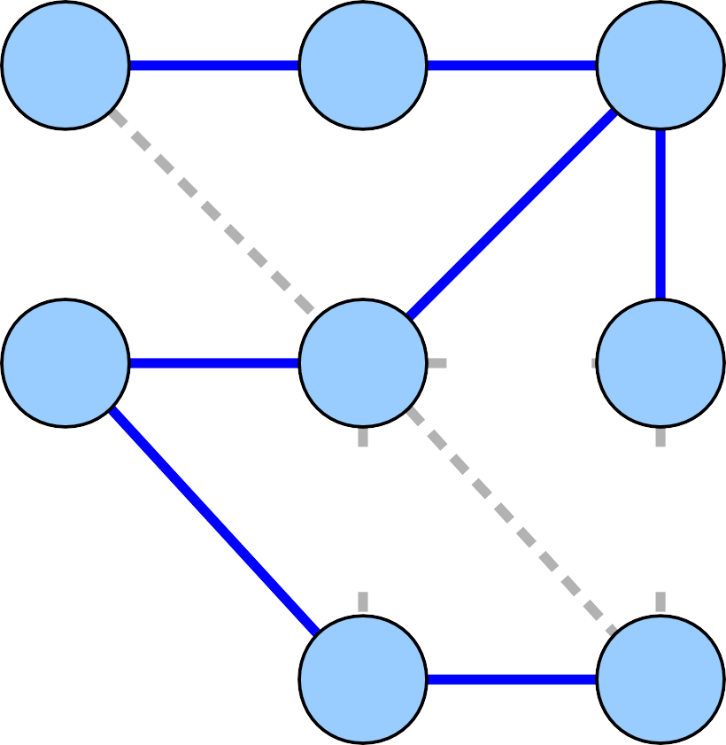
1
2
1
2
3
1
3
1
1
2
2
1
1
4
1
4
2
3
2
3
2
4
2
4
1
1

Slide 90
1
2
1
2
3
1
3
1
1
2
2
1
1
4
1
4
2
3
2
3
2
4
2
4
1
1

Slide 91
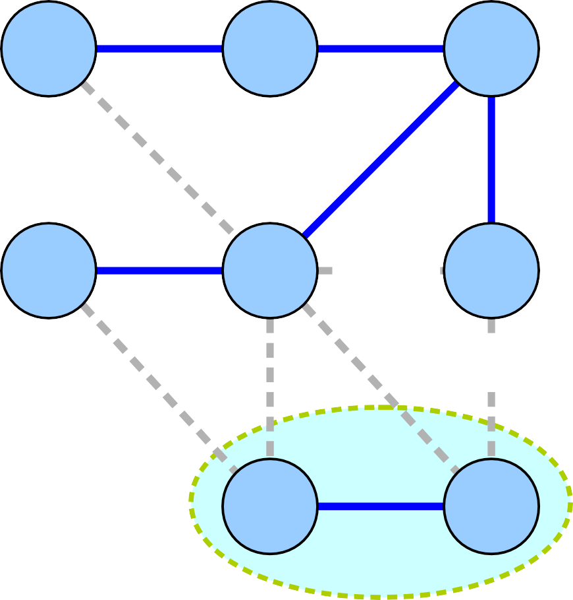
1
2
1
2
3
1
3
1
1
2
2
1
1
4
1
4
2
3
2
3
2
4
2
4
1
1

Slide 92
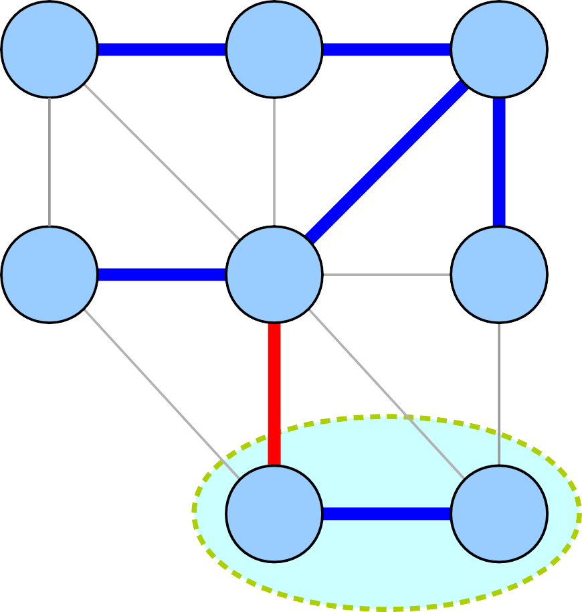
1
2
1
2
3
1
3
1
1
2
2
1
1
4
1
4
2
3
2
3
2
4
2
4
1
1

Slide 93
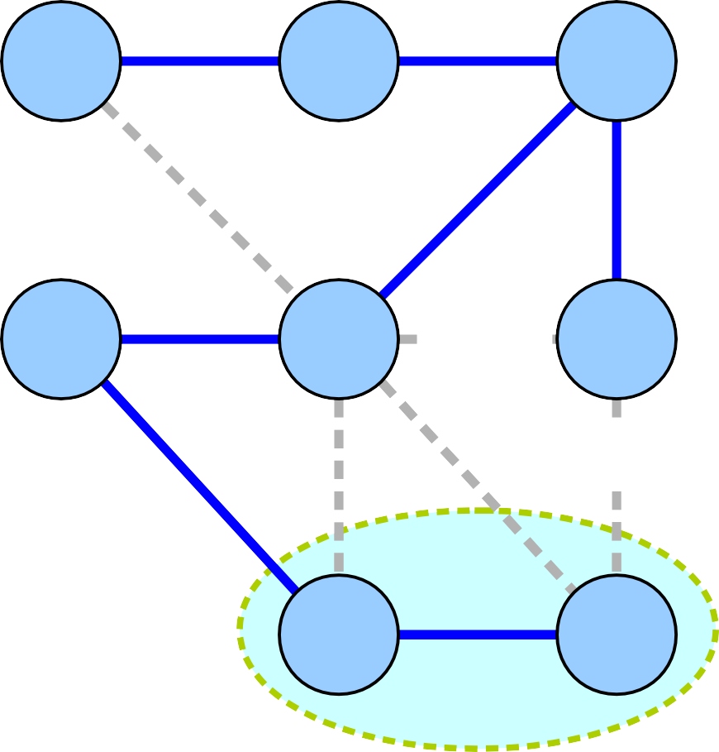
1
2
1
2
3
1
3
1
1
2
2
1
1
4
1
4
2
3
2
3
2
4
2
4
1
1

Slide 94
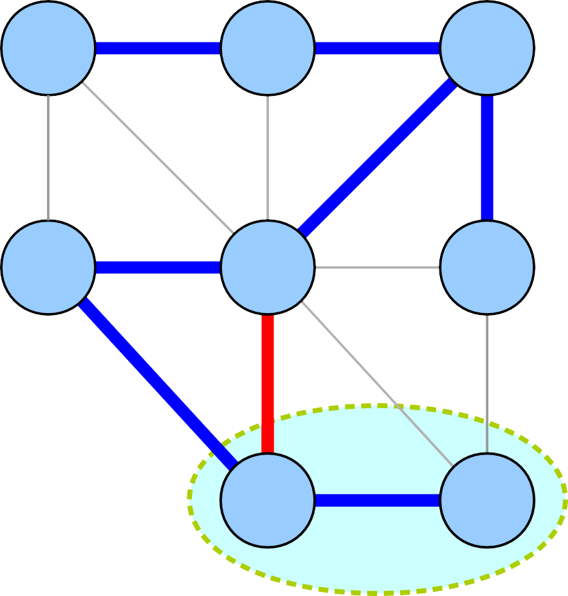
1
2
1
2
3
1
3
1
1
2
2
1
1
4
1
4
2
3
2
3
2
4
2
4
1
1

Slide 95

1
2
1
2
3
1
3
1
1
2
2
1
1
4
1
4
2
3
2
3
2
4
2
4
1
1

Slide 96

1
2
1
2
3
1
3
1
1
2
2
1
1
4
1
4
2
3
2
3
2
4
2
4
1
1

Slide 97
1
2
1
2
3
1
3
1
1
2
2
1
1
4
1
4
2
3
2
3
2
4
2
4
1
1

Slide 98
1
2
1
2
1
1
1
1
1
1
2
2
1
1

Slide 99
Correctness Proof Intuition
●
Claim: Every edge added by Kruskal's algorithm is a least-cost edge crossing some cut (S, V – S).
●
When the edge was chosen, it did not close a cycle.
Choose S to be the CC of nodes on one end of the edge to get cut (S, V – S).
Edge must be cheapest edge crossing this cut, since otherwise we would have selected a different edge.
●
●

Slide 100
Theorem: Kruskal's algorithm always produces an MST.
Proof: Let T be the tree produced by Kruskal's algorithm and T* be an MST. We will prove c(T) = c(T*). If T = T*, we are done. Otherwise T ≠ T*, so T – T* ≠ Ø. Let (u, v) be an edge in T – T*.
Let S be the CC containing u at the time (u, v) was added to
T. We claim (u, v) is a least-cost edge crossing cut (S, V – S). First, (u, v) crosses the cut, since u and v were not connected when Kruskal's algorithm selected (u, v). Next, if there were a lower-cost edge e crossing the cut, e would connect two nodes that were not connected. Thus, Kruskal's algorithm would have selected e instead of (u, v), a contradiction.
Since T* is an MST, there is a path from u to v in T*. The path begins in S and ends in V – S, so it contains an edge (x, y) crossing the cut. Then T*' = T* ∪ {(u, v)} – {(x, y)} is an ST of G and c(T*') = c(T*) + c(u, v) – c(x, y). Since c(x, y) ≥ c(u, v), we have c(T*') ≤ c(T*). Since T* is an MST, c(T*') = c(T*).
Note that |T – T*'| = |T – T*| – 1. Therefore, if we repeat this process once for each edge in T – T*, we will have converted T* into T while preserving c(T*). Thus c(T) = c(T*). ■

Slide 101
Implementing Kruskal's Algorithm

Slide 102
Kruskal's Algorithm
●
High-level overview of Kruskal's algorithm:
Let T = Ø.
For each edge (u, v) sorted by cost:
– If u and v are not connected by T, add (u, v) to T.
●
●
●
Can visit edges in order by sorting them in time O(m log n).
Can check whether u and v are connected in time O(n) by doing DFS. (Why?)
Total time required: O(mn).
●
●

Slide 103
Speeding up Kruskal's
●
The “bottleneck” in Kruskal's algorithm is checking whether a pair of nodes are connected to one another.
Goal: Optimize queries of the form “are
x and y connected?”
To do this, we will introduce a new data structure called the disjoint-set forest.
●
●

Slide 104
Set Partitions
●
A partition of a set S is a family X of nonempty sets where each element of S belongs to exactly one set in X.
Goal: Build a data structure (called a disjoint-set data structure) that efficiently supports three operations:
●
make-set(v), which places v into its own set,
union(u, v), which combines the sets containing u and v into one set, and
in-same(u, v), which returns whether u and
v belong to the same set.
●
●
●

Slide 105
Kruskal's Algorithm
●
Using our new data structure:
Let T = Ø.
Let S be a disjoint-set data structure. For each v ∈ V:
Call S.make-set(v)
For each edge (u, v) sorted by cost:
If S.in-same(u, v) is false:
Add (u, v) to T.
Call S.union(u, v).
●
●
●
●

Slide 106
1
2
3
1
2
2
1
1
4
2
3
2
4
1

Slide 107




1
2
3
1
2
2
1
1
4
2
3
2
4
1

Slide 108
1
2
3
1
2
2
1
1
4
2
3
2
4
1

Slide 109
1
2
3
1
2
2
1
1
4
2
3
2
4
1

Slide 110



1
2
3
1
2
2
1
1
4
2
3
2
4
1

Slide 111
1
2
3
1
2
2
1
1
4
2
3
2
4
1

Slide 112


1
2
3
1
2
2
1
1
4
2
3
2
4
1

Slide 113
1
2
3
1
2
2
1
1
4
2
3
2
4
1

Slide 114
1
2
3
1
2
2
1
1
4
2
3
2
4
1

Slide 115
1
2
3
1
2
2
1
1
4
2
3
2
4
1

Slide 116
1
2
3
1
2
2
1
1
4
2
3
2
4
1

Slide 117
1
2
3
1
2
2
1
1
4
2
3
2
4
1

Slide 118

1
2
3
1
2
2
1
1
4
2
3
2
4
1

Slide 119
1
2
3
1
2
2
1
1
4
2
3
2
4
1

Slide 120
1
2
3
1
2
2
1
1
4
2
3
2
4
1

Slide 121
1
2
3
1
2
2
1
1
4
2
3
2
4
1

Slide 122
1
2
3
1
2
2
1
1
4
2
3
2
4
1

Slide 123
1
2
3
1
2
1
1
4
2
3
2
4
1

Slide 124
1
2
3
1
2
1
1
4
2
3
2
4
1

Slide 125
1
2
3
1
2
1
1
4
2
3
2
4
1

Slide 126
1
3
1
2
1
1
4
2
3
2
4
1

Slide 127
1
3
1
2
1
1
4
2
3
2
4
1

Slide 128

1
3
1
2
1
1
4
2
3
2
4
1

Slide 129
1
1
2
1
1
2
1

Slide 130
Prim’s and Kruskal’s
Description
Runtime
Use-cases
Prim’s
Grows a tree
O(|E|log(|V|))
with red-black tree
O(|E|+|V|log(|V|))
with Fibonacci heap
Better on
dense graphs
Kruskal’s
Grows a forest
O(|E|log(|V|))
with union-find
O(|E|)
with union-find and radix sort
Better on
sparse graphs
and if the edge
weights can be
radix sorted.

